Slide 1
Application n.1: Does Inter-municipal Cooperation promote efficiency gains? Evidence from Italian Municipal Union Ferraresi, Migali and Rizzo
Evaluation of Public Policy

Slide 2
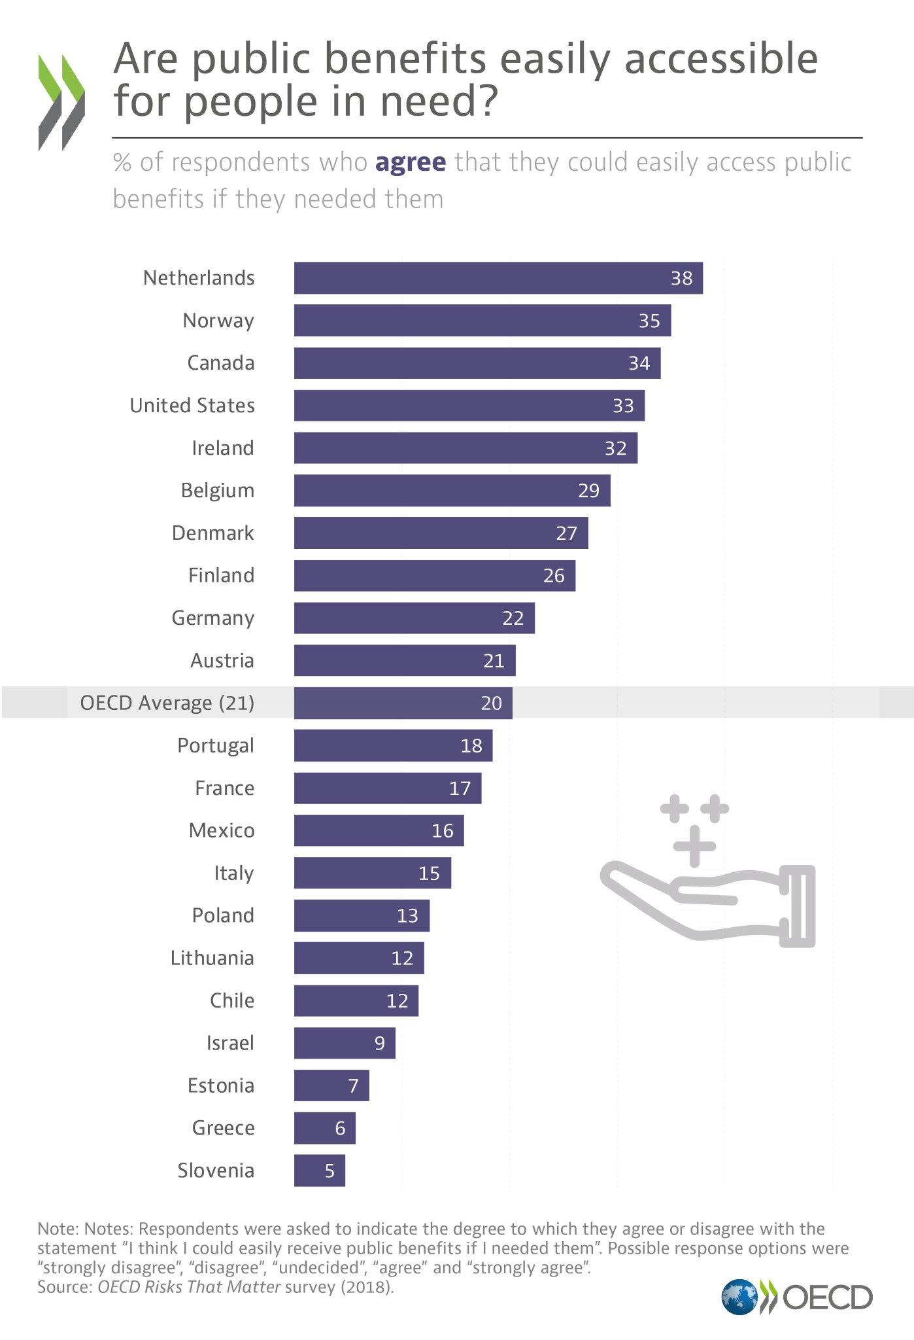
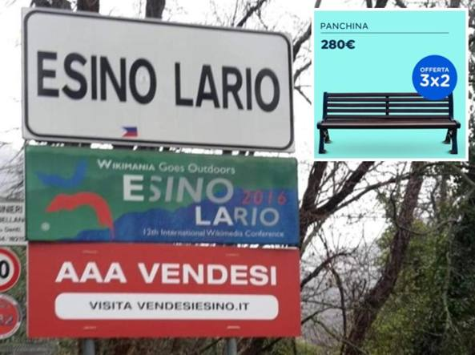
dip2
Esino for sale

Slide 3
Motivation I
In the last years municipalities across Europe have been affected by economic and government budget challenges
-> pressure on performances in terms of efficiency, effectiveness and quality of public services.
Two issues:
general increase in the demand of public goods
stricter public finance requirements imposed by European Union to local governments
-> municipalities had to reduce their expenditures.

Slide 4
Motivation II
Consequence:
difficulties for small municipalities to meet the demands of local public goods while reducing their expenditure
territorial scale no longer compatible with the increasing scale of production required to provide efficiently high standard level of public services
Possible solutions: to rethink service delivery of services through new different institutional tools
amalgamation of municipalities;
inter-municipal cooperation.

Slide 5
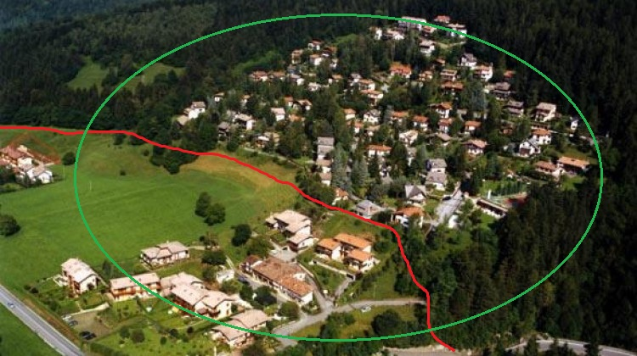
Dip 5

Slide 6
Institutional framework I
In Italy, 8.000 municipalities and 70% of them have a population lower than 5.000 inhabitants.
The Law 142/1990 has formally introduced the inter-municipal cooperation.
Each region, through its own law, can stimulate and promote Municipal Unions within its territory.
Municipalities transfer the money related to the public function(s) they want to share, and the Union provides the corresponding service(s).

Slide 7
Institutional framework II
Union is a legal entity, with its own balance sheet, its own president chosen among the mayors of municipalities joining the Union.
Its own council composed by the council members of cooperating municipalities.
The functions commonly transferred are:
Administration and Management,
Municipal police,
Education,
Roads & Transport Services,
Planning and Environment,
Social welfare.

Slide 8
Empirical approach
The organization process of Municipal Unions has not been homogeneous across regions in Italy, and over time (during the period 2001-2011).
Municipalities in Unions located in different regions are not properly comparable.
Analysis restricted to the region Emilia Romagna:
one of the richest and more populated Italian region;
inter-municipal cooperation is a widespread phenomenon.

Slide 9
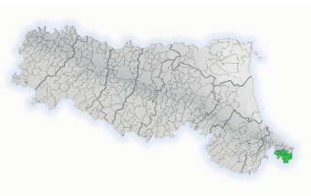
Empirical approach
In 2001 only one MU, including 9 municipalities and serving 20,767 inhabitants, around 1% of the regional population.

Slide 10
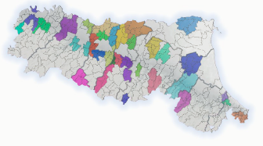
Empirical approach
In 2011 31 MU, over 160 municipalities and 1.5 million of inhabitants, that is 34% of the total population of Emilia Romagna.

Slide 11
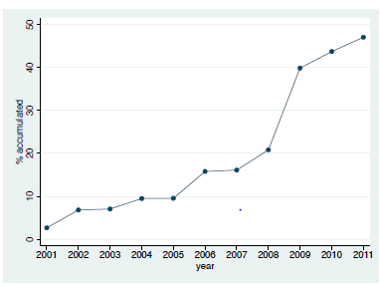
Empirical approach
The rate of participation of municipalities in Municipal Unions is less than 20% until 2007;
striking increase from 2008, reaching almost 50% by the end of the decade;
by 2016 the percentage of municipalities in unions is 81%.

Slide 12
Data
Combination of different archives from
Italian Ministry of the Interior,
the Italian Ministry of Economy
the Italian Institute of Statistic.
Information on:
to be in a Union [Municipal_Union]
municipal financial data [log_expenditure]
municipal demographic and socio-economic data [population, child, aged…]
In Emilia Romagna
348 municipalities for the period 2001-2011
we exclude Bologna, a Metropolitan Area with a wider range of services

Slide 13
Main variables
Variable | Description
log_expenditure | Log of current expenditure per resident
Municipal_Union | dummy = 1 if municipality i at time t belongs to a Municipal Union
population | Population of the municipality
child | Share of the population aged between 0-5
aged | Share of population over the age of 65
income | Real personal income tax base per resident
population_density | Numbers of citizens per area
taxpayers | Share of the taxpayers of the municipality
ipopulation | Inverse of the population
revenue_Municipal_Union | Sum of the revenue from fees and charges and transfers from other level of governments per resident
birth_rate_pc | Birth rate per capita
children_infant_school_pc | Number of children enrolled in infant school (per-capita
net_migration | Difference between new registered members and unregistered members
road_car_crash_pc | Number of accidents within the municipal roads

Slide 14
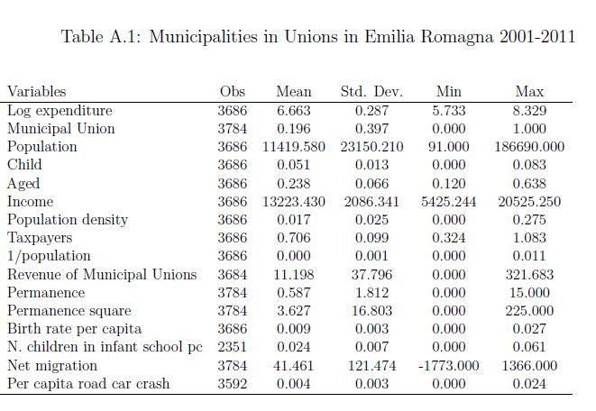
Descriptive statistics

Slide 15
Replicate descriptive statistics in Stata
Open the dataset: emilia_uni_dataset_up
use emilia_uni_dataset_up.dta,clear
Generate summary statistics:
sum log_expenditure Municipal_Union population child aged income population_density taxpayers ipopulation revenue_Municipal_Union birth_rate_pc children_infant_school_pc net_migration road_car_crash_pc

Slide 16
Identification strategy I
Objective: identify the causal effect of being a member of a Municipal Union on the spending decisions of single Municipality.
Ideal framework: to compare decisions on expenditure for Municipality in a Union (treated group), to the same decisions for Municipality in the counterfactual situation of not being in the Union.
This is impossible.

Slide 17
Identification strategy II
Best alternative is a randomized control trial:
to assign participation and non participation in a Municipal Union across municipalities, and compare the average expenditures of the two groups.
Our analysis: quasi-experimental approach
define a suitable control group that can credibly estimate the counterfactual.
Main issue: unobservable characteristics between Municipalities in Union and Not in Union, and which might be correlated to the expenditures.
Methodology used difference-in-differences remove unobservables fixed over time.

Slide 18
Difference-in-differences
For each year, we have municipalities in Unions (treated group, TG) and municipalities not in Unions (control group, CG).
We compare the change in expenditures in TG before and after the participation in a MU, to the change in expenditures in CG for the same period.
We estimate the following two-way fixed effect linear model:

Slide 19
Difference-in-differences
$Y_{it}$ is log per capita expenditure in municipality i at time t
${MU}_{it}$: dummy variable =1 if municipality i at time t belongs to the Municipal Union and zero otherwise.
$μ_{i}$ municipalities fixed effects
$τ_{t}$ exogenous shocks, common to all municipalities in period t.
$X_{it}$: time-varying demographic and socio-economic characteristics (control variables).
$γ$ is the difference-in-difference estimate of the effect of being in a Municipal Union on expenditure.

Slide 20
Control variables
Population of Municipality [population], population density (number of citizens per area) [population_density], and inverse of population [i_population]:
variables that capture scale economies or dis-economies in the provision of public goods and congestion effects.
Proportion of citizens aged 0-5 [child], proportion of citizens aged over 65 [aged]
account for some specific public needs (e.g., nursery school, nursing homes for the elderly).

Slide 21
Control variables
Average per capita income [income] proxied by the personal income tax base, and the proportion of taxpayers [taxpayers]
take into consideration different levels of wealth and tax contribution on the territory
Total per capita revenue of Municipal Union [revenue_Municipal_Union]: own total revenue + transfers from higher levels of government.
variable that allows to separate the effect of being in MU from the variation in the financial resources raised by the Municipal Union.

Slide 22
Difference-in-differences using STATA
before regression, we need to specify that we are using a panel data with the xtset command:
xtset codice_istat year
Initially we make a regression only with fixed effects, the robust option allows robust variance estimator:
xi: xtreg log_expenditure Municipal_Union i.year, fe robust
Add to the regression the control variables that we have collected with the global command:
global ind_var population population_density ipopulation child aged income taxpayers revenue_Municipal_Union
xi: xtreg log_expenditure Municipal_Union $ind_var i.year, fe robust

Slide 23
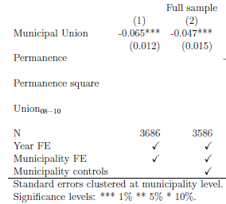
Effect of the Union on Log Expenditures

Slide 24
Heterogeneity of the policy
We evaluate whether the effect of the policy varies with respect to the permanence in Municipal Union
We take into account the length of time spent by each municipality in the Union after joining it.
This is an important issue since we are dealing with multiple treatment groups and multiple time periods.
We estimate a modified version of equation 1, where we add a continuous variable that measures the permanence in the Union (from zero to 11 years), and we also include its quadratic term.

Slide 25
Heterogeneity of the policy in STATA
We have to generate the variable permanence: "Number of years joining the Municipal Union“
With the function seq in the command egen we can create a growing sequence of numbers and also decide when to start this sequence with the option f(n)
bysort codice_istat : egen permanence = seq() if Municipal_Union==1 & year_entry>=2001, f(0)
If the municipality joins the union in 1996 the series starts from 5:
bysort codice_istat : egen permanence1996 = seq() if Municipal_Union==1 & year_entry==1996, f(5)

Slide 26
Heterogeneity of the policy in STATA
we replace the new sequence:
replace permanence = permanence1996 if Municipal_Union==1 & year_entry==1996
We replace the values of ​​for the municipalities that have not been part of a union with zero:
replace permanence = 0 if permanence==.
We create also the variable permanence_square: "Square of number of years joining the Municipal Union"
gen permanence_square = permanence^2

Slide 27
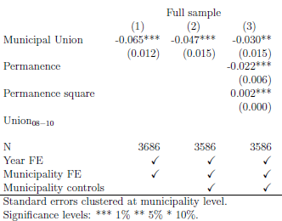
Permanence in the municipal union

Slide 28
Analysis on different outcomes I
The results show that inter-municipal cooperation increases the efficiency of the single municipality,
However, these savings might not be a real gain in efficiency but the consequence of a reduction of the level or the quality of public services.
We test whether local public services are affected by inter-municipal cooperation using four proxies of their level:
1. per capita birth rate [birth_rate_pc]
2. net migration to the municipality [net_migration]
3. per capita primary school class size [children_infant_school_pc]
4. per capita number of road accidents [road_car_crash_pc]

Slide 29
Analysis on different outcomes II
If local services were to decline we would expect a negative impact on these indicators, as a consequence of the reduction in expenditures.
For example:
poor local public services may imply lower migration and lower birth rates, as a result of lower attractiveness of the municipality.
Less expenditures may increase the school class size, a typical indicator of the quality of the school service.
A decrease in current expenditures which leads to a worsening of roads or bridges maintenance might increase car accidents.

Slide 30
Analysis on different outcomes in STATA
to check the effect on the outcome variables we replace the dependent variable in the main regression:
drop if log_expenditure==.
global ind_var2 population child aged income population_density taxpayers ipopulation
xi: xtreg birth_rate_pc Municipal_Union $ind_var2 i.year, fe robust
xi: xtreg children_infant_school_pc Municipal_Union $ind_var2 i.year, fe robust
xi: xtreg net_migration Municipal_Union $ind_var2 i.year, fe robust
xi: xtreg road_car_crash_pc Municipal_Union $ind_var2 i.year, fe robust

Slide 31
Effect of the Union on alternative output

Slide 32
Propensity score matching
Allows to select a group of non-treated individuals similar to the treated ones in all the relevant pre-treatment characteristics (X) => overcomes selection bias
If this is so, the difference in outcomes can be attributed exclusively to treatment.
The propensity score (PS) corresponds to the conditional probability of receiving the treatment given the pre-treatment variables:
$$p\left(X\right)=\operatorname{Pr}\left(D=1 | X\right)=E(D|X)$$

Slide 33
Propensity score matching
Two potential sources of bias
1. effect of entering a Union is not homogeneous
2. the effect varies according to the characteristics of the municipalities.
Solution: propensity score matching models.
The main purpose is to find a group of non-treated municipalities, who are similar to the treated in all relevant pre-treatment characteristics: the only remaining difference being that one group enters a Union and another group does not.

Slide 34
Propensity score matching
Estimation of the propensity score
The probability of entering a U conditional on pre-treatment characteristics x, P(x) = Pr(MU = 1|x)
We use data from the 2001 Census and run a logit regression:
dependent variable: dummy =1 if a municipality in MU between 2001-2011 and zero otherwise.
control variables: municipality located close to the coast, rural municipality, surface in square km of the municipality, municipality located in plain, on hills, and in mountains; municipal unemployment rate; number of houses; number firms; interaction between surface and houses; interaction number firms and unemployment rate.

Slide 35
Propensity score matching
Estimation of the propensity score
Once we have obtained the (PS) we adopt a trimming procedure to define the common support
We re-estimate main regression equation by using information only on the observations that lie on the common support.

Slide 36
PSM in STATA
* Generate common support
use emilia_uni_dataset_up.dta,clear
xtset codice_istat year
*Definition of important variables before treatment
global psvar coastal_zone rural_municipality area altimetry_zone unemployed houses square_area int_houses int_unemployment firms
* ONLY observation before the treatment
keep if year==2001
** if the command pscore is not installed on your PC
findit pscore

Slide 37
PSM in STATA
pscore unu $psvar, pscore(pscore) comsup level(0.10)
keep codice_istat pscore comsup
tab comsup
save sample_matching.dta,replace
* Merge matching dataset with the principal dataset
use emilia_uni_dataset_up2.dta,clear
merge codice_istat using sample_matching.dta
drop _merge
save emilia_uni_dataset_common.dta,replace

Slide 38
PSM in STATA
use emilia_uni_dataset_common.dta, clear
** Table 2 - Effect of the Union on Log Expenditures
*** col.4 - Matched sample: equation 1 (no control variables)
xi: xtreg log_expenditure Municipal_Union i.year if comsup==1, fe robust
*** col.5 - Matched sample: equation 1 (with control variables)
global ind_var population child aged income population_density taxpayers ipopulation revenue_Municipal_Union
xi: xtreg log_expenditure Municipal_Union $ind_var i.year if comsup==1, fe robust
*** col.6 - Matched sample: equation 1 (with control variables and permanence)
xi: xtreg log_expenditure Municipal_Union permanence permanence_square $ind_var i.year if comsup==1, fe robust

Slide 39
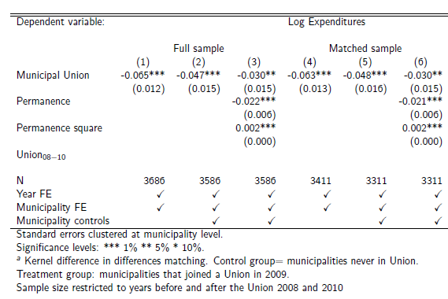
Propensity score matching

Slide 40
Conclusion
We analyzed the Italian experience of Municipal Unions, using unique administrative data on the municipalities in Emilia Romagna region.
We employed a DiD approach to estimate the causal effect of being member of a Municipal Union on local expenditures.
Participation to a Union reduces total current per-capita expenditures by 5%, compared to municipalities not in Union.

Slide 41
Conclusion
Effect persistent and increases up as the permanence in the MU increases.
Entering a Union do not decrease the quality of public services.
We conclude that MU is an efficient tool that allows municipalities to gain efficiency, in terms of a reduction in public expenditures.

