Slide 1
Evaluation of Public Policy
Lecture 1
Introduction STATA
Rossella Iraci Capuccinello

Slide 2

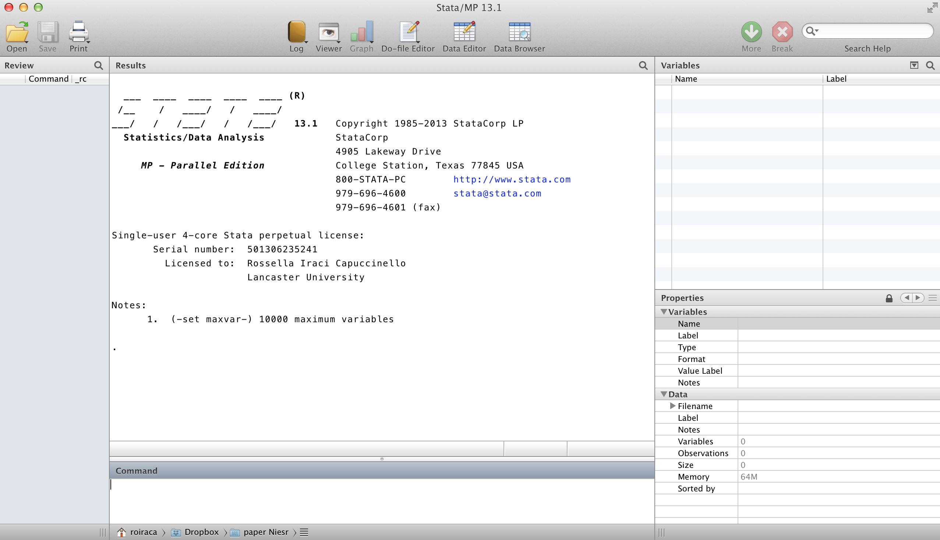
Getting started in STATA
Start STATA
  Simply click on icon
  Stata should look like this:
    Buttons/menu
    Review window
    Results window
    Command
    entry window
    Variables window
To exit type:
  exit

Slide 3
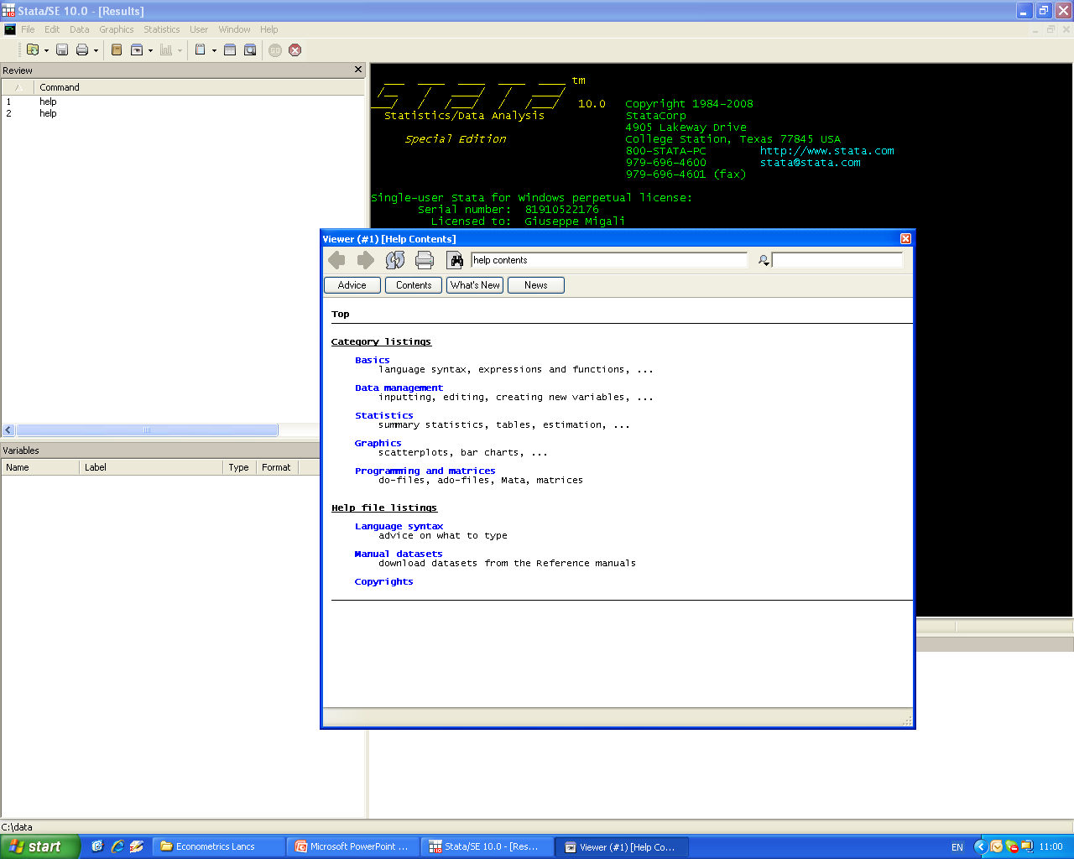
Getting help
Lots of on-line help
Click on help on menu
Type help xxx for help on the “xxx” command

Slide 4
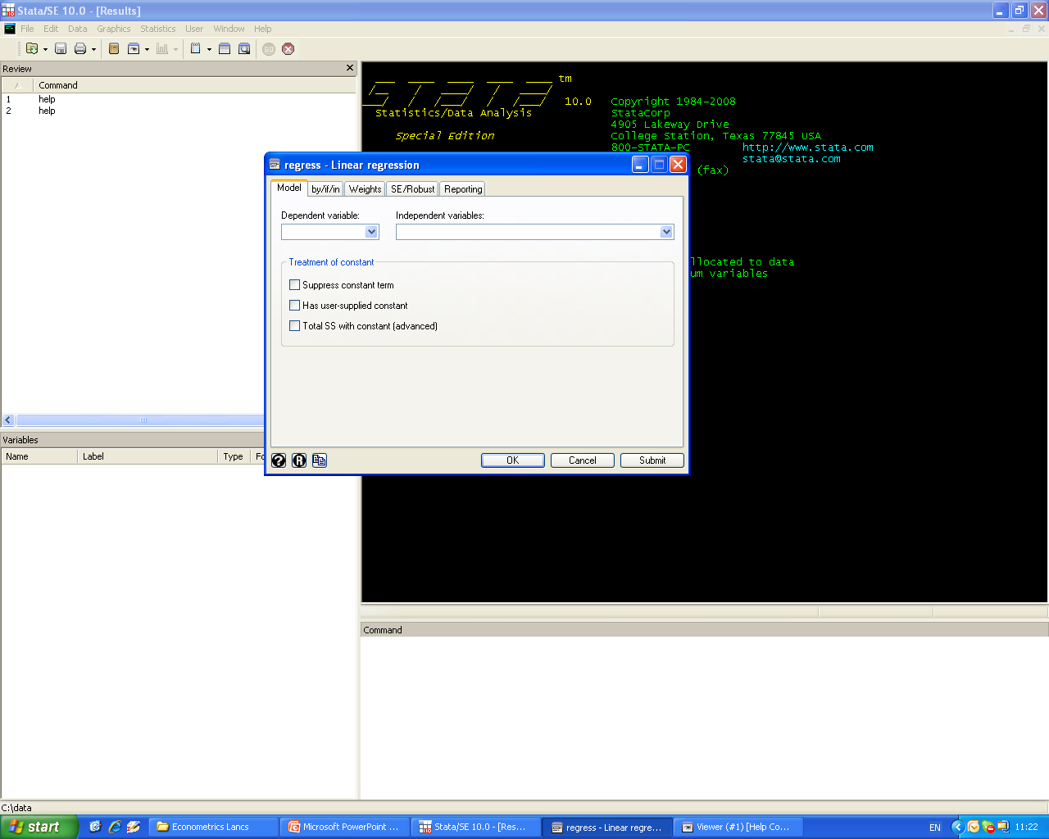
Click and point
Use the menu bar to click and point to most commands
Then fill in the boxes in the resulting dialog box
Click on tabs for further options

Slide 5
Important features
NOTE
  Always use lowercase in STATA
  ren *, lower
More
  When you see --more-- press the spacebar! Or type set more off or set more off, perm to make it permanent
Break
  To stop scrolling output, hit the red cross (Ctrl-Break)
Not enough memory
  set mem XXXm (resizes to allow XXX mb)
  set matsize XXX ( max matrix to XXX square)
Type set to check all Stata settings

Slide 6
Loading up some data
You will usually want to open some dataset
  Stata expects datasets to be rectangular with columns being variables and rows being obs
Several ways of getting data into STATA:
  use myfile (or click file open on the menu bar)
    (opens a stata format file called myfile.dta)
  use var1 var2 var3 using myfile in 1/1000 if var4==1
    (loads var1, var2, var3 for the first 1000 obs if var4=1)
  insheet using myfile.csv (or .txt)
    imports csv file which Excel can read (or “text” file)
clear clear memory

Slide 7
Data
Huge variety of datasets from data archives
  UKDA , ICPSR, and around the world:
    www.esds.ac.uk/international/access/map.asp
  Research centres
    NBER www.nber.org
  Government depts and international agencies
    US Census Bureau and World Bank
  And journal websites (like AER)
    Most major journals make datasets and code easily available

Slide 8
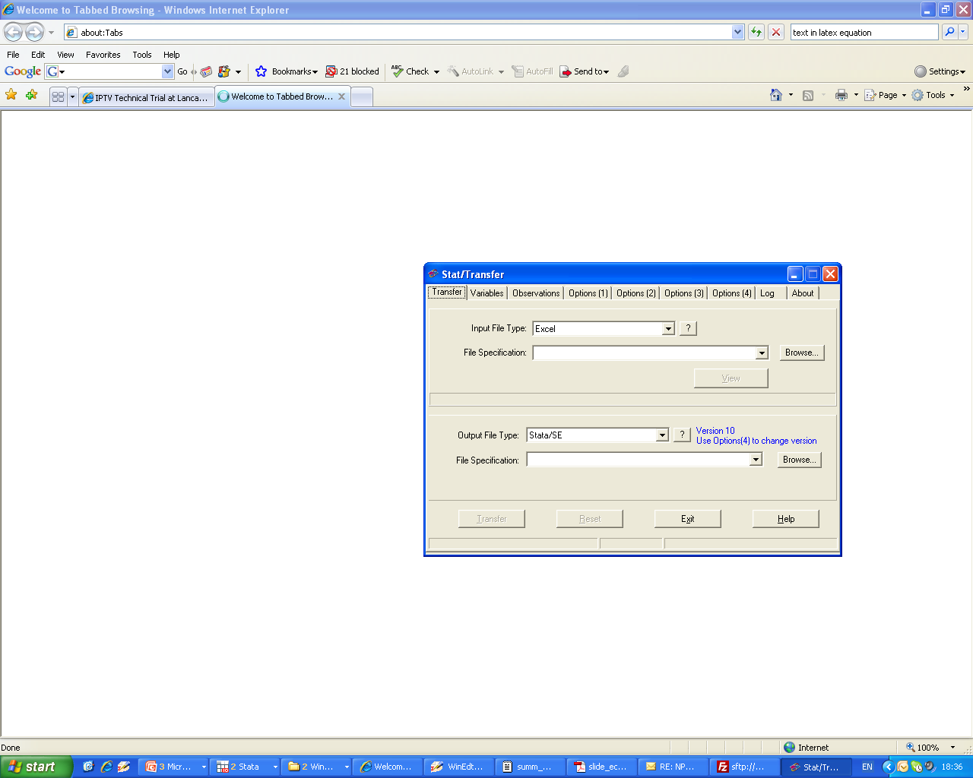
Stat-Transfer
Use STAT-TRANSFER to convert data.
Click on
Stat-transfer is “point and click”.
Just tell it the file name and format
and the format you want it in.
Click “transfer”.

Slide 9
Practicising
Import Stata’s own demos sysuse
  E.g. sysuse auto
Many datasets available at specific sites
  E.g. STATA’s own site has all the demo data
Use the webuse command to load the files directly into stata without copying locally
  webuse auto /* gets auto from www.stata.com*/

Slide 10
Web resources
STATA is web-aware
  update /*updates from www.stata.com*/
Statalist is an email listserv discussion group
The Stata Journal is a refereed journal
SSC Boston College STATA Archive
  Files can be downloaded in Stata using ssc
    E.g. ssc install outreg2
    Installs the outreg2 ado file that makes tables pretty
    findit finds ado files from the web
    lookfor finds variables in your data set searching for strings among varnames and labels

Slide 11
Keeping track of output
STATA allows you to scroll back your screen
But better to open a log file: it saves commands as well as output
Click on file, log, begin . Or type
  log using myoutput
  my commands……………………
  list age
  log close
You can turn logging off and back on
  log off then log on when ready to resume
log command allows the replace and append.

Slide 12
Saving output
Default is a .smcl file extension (to “view”)
You might prefer to give your own, say, .log, .txt
  then you get an ASCII file that anything can edit
  you can translate files to and from .smcl format
    click on file, log, translate and fill in the dialog box
It doesn’t save graphs
  Copy graphs (use cut and paste or use menus)
Cd or pwd show the current directory, to change it type
  cd"C:\Documents\Course Ecmtrx\myfolder”
  ls show the files in the directory

Slide 13
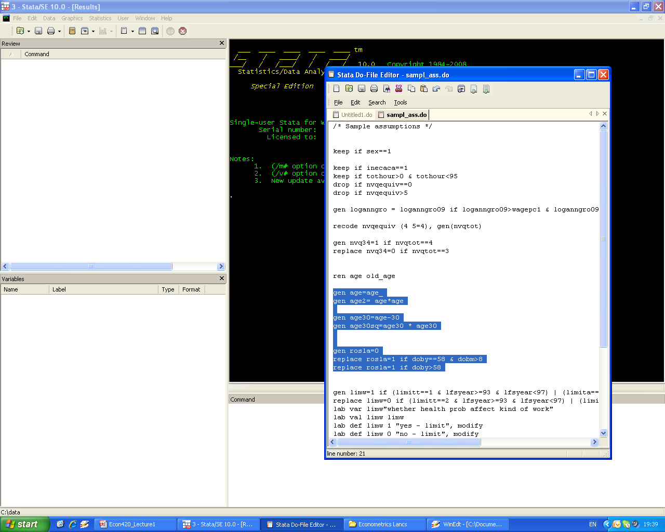
STATA’s command file editor
STATA has an editor that allows you to create do files
  Enter cmds – 1 per line
  Save the commands in a “do” file
  Highlight commands and click the button with page (or page with text) and right arrow to “run” (or “do”) commands.

Slide 14
Command .do files
More complicated ideas can be implemented as a sequence of commands. For example:
list var1 var2 var3 in 1/10 if var4>=0
  Lists the first 10 rows of var1 to var3 for which var4≥0
Collect commands in the editor, save .do file.
Then type do mycommands.do, nostop
  echoes to screen, and keeps going after error
Or run mycommands.do executes “silently”
Notes:
14

Slide 15
Saving commands
It is ALWAYS good practice to use a .do file
  easy to develop ideas and correct mistakes
Logging your output is a good way of developing a .do file
  since it saves the commands as well as output
Or you can just log the commands
  Type cmdlog using xxx.txt
Then save the file for subsequent analysis
    save newfile
    save, replace take care – it overwrites

Slide 16
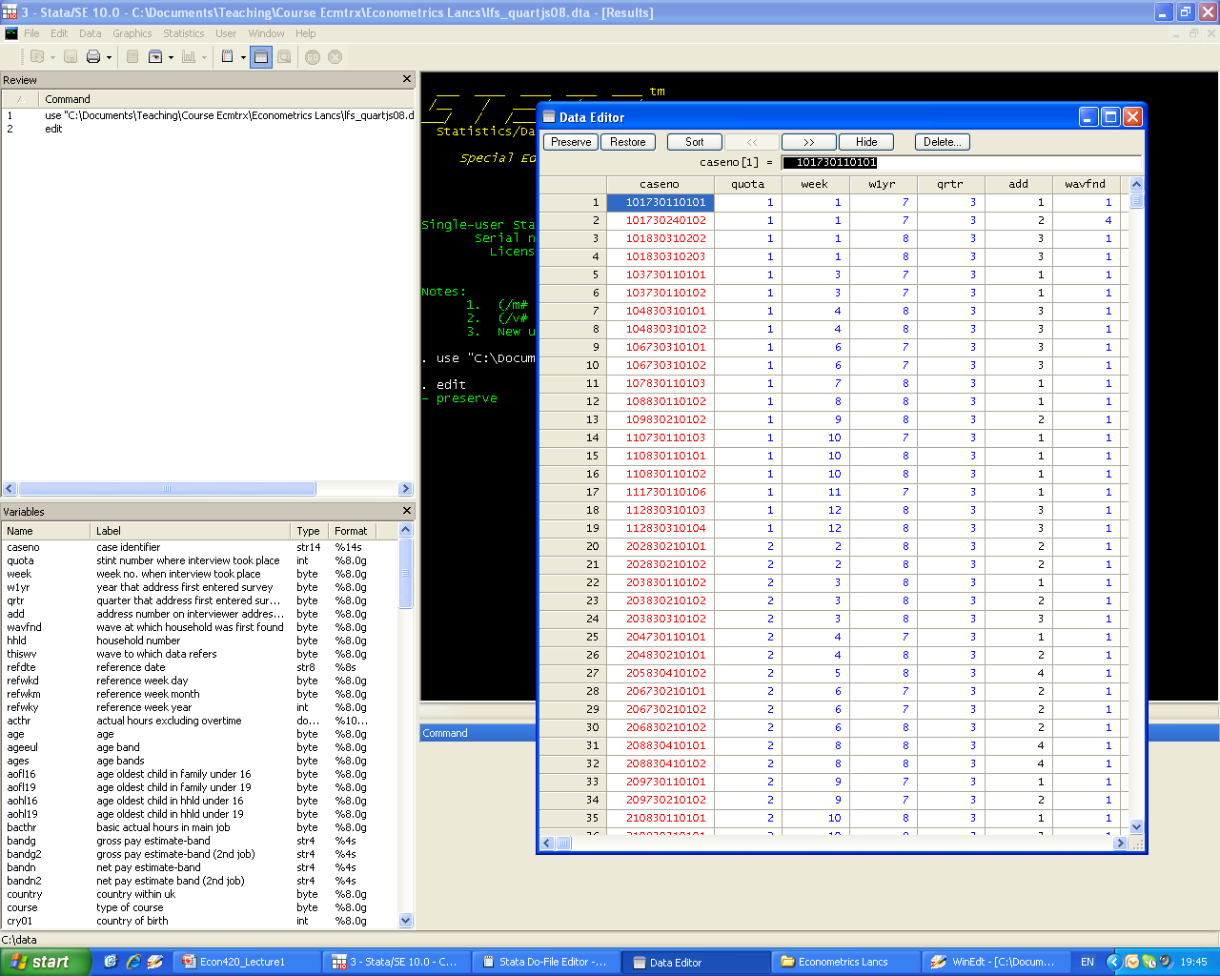
Using the data editor
Open a datafile (eg.lfs_3rdquart08.dta)
Click on the icon
Or type edit
You can edit datapoints!
Or just browse the datafile

Slide 17
Basic data reporting
describe (or press F3 key)
  Lists the variable names and labels
  describe using myfile
  Lists the variable names etc WITHOUT loading the data into memory (useful if the data is too big to fit)
codebook (you can also use inspect)
  Tells you about the means, labels, missing values etc

Slide 18
First look at the data
summ x1 x2 (or summarize or sum or su)
  Gives you the means, std devs etc for x1 and x2
corr x1 x2 in 1/100 if x4<0 (,cov)
  correlation coeffs (or covariances) for selected data
  pwcorr x1 x2 x3 does all pairwise corr coeffs
tab x1 x2 (or tabulate)
  gives a crosstab of x1 vs x2
  use only if x1 and x2 are integers

Slide 19
Tabulating
tab x1 x2 if x4==0, sum(x3)
  gives the means of x3 for each cell of the x1 vs x2 crosstab for obs where x4=0 (note ==)
tab x1 x2, missing
  Includes the missing values
tab x1 x2, nolabel
  Uses numeric codes instead of labels
tab x1 x2, col
  Gives % of column instead of count
table degree71 ethnic, c(mean age) row col
  Customises the table

Slide 20
Data manipulation
Data can be renamed, recoded, and transformed:
  gen logwgr=log(grsswk)
  gen agesq=age^2 ^ raises to the power
  gen id = _n _n is obs # in STATA
  gen ylagged=y[ _n-1 ]
  replace rate=rate/100 rescale the var
  replace age=25 if age==250
  rename agesq agesquare

Slide 21
Sorting data
sort and count
  sort id
    sorts data by person id
  count if id == id[_n-1]
    counts how many unique separate personids
    _n-1 is the previous observation
  duplicates report id
    same function count if

Slide 22
Extended generate (egen)
egen
Useful when you need a new variable that is the mean, median, etc. of another variable
  for all observations or for groups of observations.
Also useful when you need to simply number groups of observations based on some classification variables.
Great when you have panel data
Notes:
22

Slide 23
egen examples
egen sumvar1 = sum(var1)
  creates sumvar1 as sum of values of var1
egen meanvar1= mean(var1), by(var3)
  creates meanvar1 as mean of all values of var1
egen counter = count(id), by(company)
  creates count as the number of companies with nonmissingid’s
egen groupid = group(month year)
  assigns a number to each month/year group
Notes:
23

Slide 24
Handling string variables
encode
Use encode when the original var is a character var (e.g. gender is "m" or "f’")
encode command does not produce dummy variables, it just assigns numbers to each group defined by the character variable.
In this example, gender was the original character var and sex is new numeric var:
    encode gender, gen(sex)
decode does the opposite
destring
Notes:
24

Slide 25
Dummy variables
gen wales_resid=0
replace wales_resid=1 if uresmc==17
gen region17=(uresmc==17)
to create a series of dummies from a categorical var
  tab uresmc, gen(dresid)
  xi: sum i.uresmc
recode uresmc (1/16=1) (18 19=2) (17=3) (20=4), gen(state_resid)
gen engwales_resid= 0 if state_resid==3
replace engwales_resid=1 if state_resid==1

Slide 26
Labelling
Always a good idea to have your data comprehensively labelled
  label data “LFS third quarter 2008”
  label var state_resid "residence by country"
  lab values state_resid state_resid
  lab def state_resid 1 "england" 2 "scotland" 3 "wales" 4 "north ireland", modify cmd in 1 row
Tedious to do for lots of variables
  but then your output will be intelligibly labelled
  other people will be able to understand

Slide 27
Using STATA as a calculator
display command
  dis 22/7
  disp log(250)
  di exp(3.6)
  di chiprob(2,6.45) (i.e. 2 df, deviance 6.45)
    returns 0.398 (i.e. its significant at 5% level)
  display _N
    Returns the sample size
      (_N is the number of the last obs)
Notes:
27

Slide 28
Data selection
Organise your data with various commands:
    keep if _n<=1000 _n is the obs number
    drop x1
    drop if x2 ~=1
keeps only the first 1000 obs, drops x1, and drops all the observations where the variable x2≠1 (~= is “not equal to”)

Slide 29
Syntax to remember
>= means "greater or equal",
& means "and",
| means "or"
= means “set equal to”
== means “is it equal to?”
~= means “not equal” (or use != )
. means missing value
For example
  keep if x1>= 1 & x2<=3 | x2==7 & x3 ~= .
Notes:
29

Slide 30
Functions
Lots of functions are possible.
See help functions
  Obvious ones like
    log(), abs(), int(), round(), sqrt(), min(), max(), sum()
  And many very specialised ones.
  Statistical functions
    distributions
  String functions
    Converting strings to numbers and vice versa
  Date functions
    Converting dates to numbers and vice versa
  And lots more

Slide 31
Merging data - 1
file1 has id x1 x2 x3 , file2 has id x4 x4 x5.
You can merge using “key” in BOTH files (id)
But you need to sort both files first.
    use file1
    gen id =_n if personid doesn’t exist already
    sort id sorts file1 according to id variable
    save, replace
    use file 2
    gen id =_n
    sort id sorts file2 according to id variable
    merge id using file1
    drop if _merge~=3 drops obs with any missing info
    save file3
Notes:
31

Slide 32
Merging data - 2
For each row (id) all vars in file1 added to corresponding row of file2 (if there is one).
merge creates a new variable, _merge
  which =1 for those obs only in file1, =2 for those only in file2, and =3 for those in both.
So the syntax above drops those obs that don’t have data in both files
  and saves the result containing x1-x6 in file3
append to add more obs on the same vars.
Notes:
32

Slide 33
Collapsing data (use with care)
collapse converts the data in memory into a dataset of means (or sums, medians, etc.)
This is useful when you want to provide summary info at a higher level of aggregation
  For example, suppose a dataset contains data on individuals – say their region and whether u/e
  To find the average u/e rates across reg type:
  collapse unemp, by(region)
leaves 1 obs for each reg and mean u/e rate.
Notes:
33

Slide 34
Reshaping files
Data may be “long” but thin
  Eg each record is a household member
  But there are few vars - say wage and hours
Data may be “wide” but short
  each record is a household and has lots of vars
  (eg w1 w2 w3 hours1 hours2 hours3)
reshape long inc ue, i(id) j(year) wide to long
reshape wide inc ue, i(id) j(year) back to wide
Handy for merging data together and for panel data
Notes:
34

Slide 35
Some useful websites
Stata’s own resources for learning STATA
  Stata website, Stata library, Statalist archive
  http://www.stata.com/links/resources1.html
Michigan’s web-based guide (for SA)
UCLA resources
  http://www. ats.ucla.edu/stat/ stata/
ESDS “Stata for LFS”
Princeton; Illinois; Gruhn
Notes:
35

