Slide 1
Optimal Consumption Taxation
University of Ferrara
Academic course 2016-17
Prof. Alejandro Esteller-Moré (aesteller_at_ub.edu)

Slide 3
Outline
0.Direct vs. Indirect Taxes: a taxonomy
Brief justifications for taxing consumption
Ways to tax consumption
Problems with taxing consumption
Some basic data
Optimal taxation: no redistribution concerns
Optimal taxation: with redistribution concerns
Basic references

Slide 4
Recall…
We need taxes (compulsory) – given the existence of the public sector –
- To finance the provision of public goods (implicit redistribution: utilitarian framework), and
- To redistribute income (explicit: SWF where individuals are weighted differently)
In any case, the 2nd SWT does not hold as long as lump-sum taxes (only way to transfer resources across individuals) are unfeasible (private information): then, taxes are based on actions/outcomes (i.e., consumption, income or saving) rather than characteristics/ability.
This produces welfare losses (EB/”Harberger Triangle”) because the distorting nature of taxes (this loss is measured in terms of quantities: will see next in OCT).
Optimal taxation is about the minimization of these losses

Slide 5
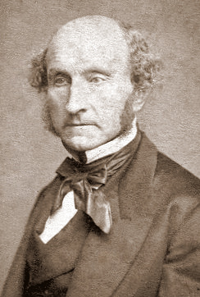
0. Direct vs. Indirect Taxes: a taxonomy
J. S. Mill (1848): “A direct tax is one which is demanded from the very persons who, it is intended or desired, should pay it. Indirect taxes are those which are demanded from one person in the expectation and intention that he shall indemnify himself at the expense of another: such as the excise or customs.”
A. B. Atkinson (1977): “Historically the distinction no doubt arose from the method of administration, in that the taxpayer handed over income tax directly to the revenue authorities, but only paid sales taxes indirectly via the purchase of goods…”
J.M. Buchanan (1970): “Direct taxation is defined as taxation imposed upon the person who is intended to the be the final bearer of the burden of payment”… “Direct taxes may be adjusted to the individual characteristics of the taxpayer, whereas indirect taxes are levied on transactions irrespective of the the circumstances of buyer or seller.”

Slide 6
0. Direct vs. Indirect Taxes: a taxonomy
J. S. Mill (1848): “A direct tax is one which is demanded from the very persons who, it is intended or desired, should pay it. Indirect taxes are those which are demanded from one person in the expectation and intention that he shall indemnify himself at the expense of another: such as the excise or customs.”
A. B. Atkinson (1977): “Historically the distinction no doubt arose from the method of administration, in that the taxpayer handed over income tax directly to the revenue authorities, but only paid sales taxes indirectly via the purchase of goods…”
J.M. Buchanan (1970): “Direct taxation is defined as taxation imposed upon the person who is intended to the be the final bearer of the burden of payment”… “Direct taxes may be adjusted to the individual characteristics of the taxpayer, whereas indirect taxes are levied on transactions irrespective of the the circumstances of buyer or seller.”

Slide 7
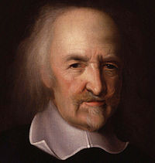
1. Brief justifications for taxing consumption (I)
Given we already tax income (as a “proxy” of ability to pay), why (also) tax consumption? Different approaches to answer this question:
- Philosophy: “It is fairer to tax people on what they extract from the economy, as roughly measured by their consumption, than to tax them on what they produce for the economy, as roughly measured by their income.” - Thomas Hobbes, Leviathan, 1651.
… probably, this is not enough…

Slide 8
1. Brief justifications for taxing consumption (& II)
But leaving aside philosophical issues, there might still be some reasons to tax consumption:
- Economics: 1) efficiency: in contrast to a tax on income, it does not distort the decision about either consuming or saving… in the end, even if I save today, my consumption will be taxed in the future… However, it will still distort leisure vs. labour supply (there is no such a perfect tax); 2) equity: “weak separability theorem”.
- Tax technology: it’s a way to tax those sources of income that might be difficult to tax at source (PIT, but also CIT) (Boadway et al., 1994); in theory, VAT even generates self-compliance (see, e.g., Keen & Smith, 2007) (see, though, http://www.cesifo-group.de/portal/pls/portal/docs/1/1193756.PDF)
… in fact, and with a focus on VAT, this makes some authors to label it as a “tax machine” (Keen & Lockwood, 2006) --- probably, this is the reason why the US Congress in the cartoon do not want it (http://www.becker-posner-blog.com/2010/04/should-the-us-introduce-a-value-added-tax-becker.html)

Slide 9
V (dummy variable)=1 if there is a VAT

Slide 10
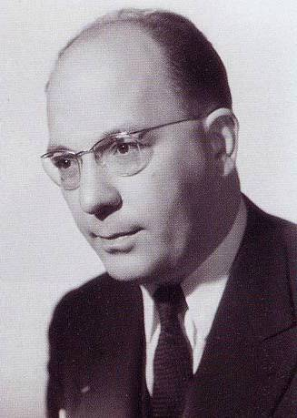
1I. Ways to tax consumption
There are at least three ways to tax general consumption, being the first two technologically different, and the last one conceptually different:
VAT (all OECD countries, but the US; first, Finland/France in 1965, being Maurice Lauré the inventor of the tax; Australia the last one in 2000): in theory at a uniform tax rate, all consumption is taxed by means of taxing added value at each stage (from the wholesaler till the retailer)
GST (no federal US tax, but State taxes): only consumption at the retailer level is levied
Expenditure tax (history and basic analysis of the tax: www.library.unt.edu/gpo/acir/Reports/information/M-84.pdf; practical application: www.hooverpress.org/productdetails.cfm?PC=1274): progressive tax rates, and would imply abolishing PIT, but also CIT -- It does not exist as such in practice, though… implicitly, does it? (www.nytimes.com/2012/01/22/business/four-keys-to-a-better-tax-system-economic-view.html?_r=0)
… we leave aside the Turnover tax (or cascade tax), which has very bad efficiency properties (taxes input or intermediate goods… against Diamond and Mirlees, 1971)

Slide 11
III. Problems with taxing consumption
We already said there is no such a perfect tax. Hence, a consumption tax:
Distorts labour supply (it does make any difference taxing my wage or taxing when I consume it: in both cases, leisure becomes cheaper)--- efficiency costs
They are regressive at one point of time if taxes are uniform, while they would be inter-temporally so if we strictly followed the Ramsey rule (https://www.ifs.org.uk/uploads/publications/wps/WP201617.pdf)…---equity costs
Positive aspect: (some degree of) fiscal illusion? (… invisible and/or efficient source of revenue?... only the latter would be welcome; so knowing whether it generates more revenue because its efficiency or because its invisibility might be a fruitful research, i.e., potential improvement of K & L, 2006)
As an example of a quantification and general assessment of costs 1) and 2), see http://pareto.uab.es/jconesa/prensa/PaperFedea.pdf

Slide 12
IV. Some basic data (I)
General consumption taxation (increasing importance; Spain as an outlier due to evolution and level)
Fiscal devaluation: http://www.ieb.ub.edu/files/IEB%20REPORT%201_2013.pdf

Slide 13
IV. Some basic data (II)
VAT (increasing importance; US as an outlier)
Source (this and previous graph): http://stats.oecd.org/Index.aspx?QueryId=21699#

Slide 14
IV. Some basic data (& III)
VAT (a race to the top within the EU(15)!!)
Source: ec.europa.eu/taxation_customs/resources/documents/taxation/vat/how_vat_works/rates/vat_rates_en.pdf

Slide 15
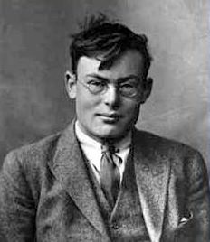
V. Optimal taxation: no redistribution concerns (I)
General Comments (I)
Original work by Ramsey (1927)
We implicitly abstract from incidence issues (taxes are paid by consumers; producer prices are fixed, infinitely elastic supply)
No lump-sum taxes (no way to observe high-ability individuals), otherwise taxing consumption would not make sense (2nd Theorem of Welfare Economics) – and no other taxes available
Taxes are linear, i.e., they do not depend on the level of consumption (administratively unfeasible) --- compatible with a GST or a VAT, but an expenditure tax would work differently (non-linear: income)

Slide 16
V. Optimal taxation: no redistribution concerns (II)
General Comments (& II)
Normative focus: Benevolent Policy-Maker (alternatively, e.g., Acemoglu et al., 2011), so…
Objective function: Social Welfare Function (SWF) that aggregates individual utility functions, subject to a (binding) budget constraint employed to provide public goods and services.
Social judgements are behind a SWF(see, for example, https://scholarsbank.uoregon.edu/jspui/bitstream/1794/3421/1/UO-2006-4_Lambert_Sacrifice.pdf, and the references cited therein for a connection with the equal sacrifice approach):
Neutral (utilitarian)
In favour of redistribution (Rawlsian, or in general those where a concave transformation is applied to the sum of individual utilities) --- Convex Social Indifference Curves

Slide 17
V. Optimal taxation: no redistribution concerns (III)
Analytical development: notation and basic assumptions
There are H-identical consumers
n stands for the number of goods and services taxed, such that we have i=0,…, n.
The service i=0 is leisure (we assume (?) people derive pleasure from simply doing nothing), which crucially is not taxed. Then, from now on, leisure will be denoted by x₀, h= maximum number of working hours, and l=number of hours worked, such that l=h-x₀
The salary (per hour) is normalized to 1, w=1(labour numeraire)
On the taxation side, we will work with unit taxes, t. That is, being the (fixed) producer price, p: q=p+t, where q is the price paid by the consumer for a given good or service. Otherwise, we could have ad-valorem taxes. Working with the former will ease the analytical development. However, it is immediate transforming one into the other, and vice versa; that is,
τ=t/q= θ/(1+θ) (including taxes) θ=t/p=τ/(1-τ) (excluding taxes; VAT)

Slide 18
V. Optimal taxation: no redistribution concerns (IV)
Analytical development: Benchmark (max. in absence of taxes)-
Max U(x₀,x₁,…,x_{n})
x₀,…x_{n}
s.a. l=q₁x₁+q₂x₂+…+q_{n}x_{n}
Where α is the private marginal utility of income, which is strictly positive (budget constraint is binding). Given the absence of taxes, q=p. Let’s simplify s. t. i=0,1.
Then, RMSx_{o},x₁= ( U/ x_{o})/( U/ x₁)=1/q₁ = -dx₁/dx₀ (price of leisure=real salary; my incentives to consume x_{o} will increase the higher q₁, and the lower the salary per hour). All in all, this determines the optimal (private=social; 1st Theorem of WE) level of x₁* and of x₀*.

Slide 19
V. Optimal taxation: no redistribution concerns (V)
Analytical development: DWL (max. in presence of taxes)
Max U(x₀,x₁)
x₀, x₁
s.a. l=(p₁+t)x1
Then, it is immediate to show now that RMSx*_{o},x*₁= ( U/ x*_{o})/( U/ x*₁)>1/(p₁+t). The individual will have to change its behaviour… We move to a 2nd-best…
Taxes have created a distortion (have implicitly made leisure cheaper); this will certainly make the individual move to a 2nd-best equilibrium, and so create an inefficiency (utility loss above the income effect) as long as the elasticity of substitution is different from zero. Then, in our example, the second best will imply an increase in x₀ and a decrease in x₁.
The quantification of the efficiency loss is so-called deadweight loss of taxation (DWL), and graphically is the “triangle of Harberger”. Our approach to taxation will try to identify the rules that minimize this loss (and so maximize SW however it is defined).

Slide 20
V. Optimal taxation: no redistribution concerns (VI)
Analytical development: OPTIMAL consumption taxes (i)
Let’s then endogenously determine t_{i}, i.e., maximize social welfare s.t….
Budget constraint: (recall this is not a zero sum game: no explicit redistributive reasons to levy taxes)
We will solve by backward induction: the Social Planner will set taxes taking into account the optimal behaviour of the (representative) taxpayer
Characterization of the optimal taxpayer behaviour: v(q,w,Y), where v(.) is the indirect utility function, which accounts for the maximum utility level…. given the exogenous variables/parameters: q, w, Y. The optimal decisions are characterized such that l=l(q,w,Y) and x₁(q,w,Y), x₂(q,w,Y)… x_{n}(q,w,Y) where q is the vector of prices of the set of commodities available (q=(q₁,q₂,..,q_{n}))
Then, recall from Roy’s identity:

Slide 21
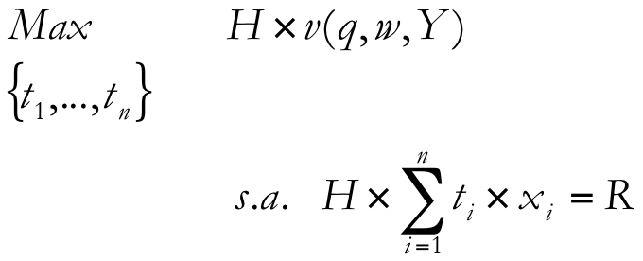
V. Optimal taxation: no redistribution concerns (VII)
Analytical development: OPTIMAL consumption taxes (ii)
Social Planner maximization problem (can show this is equivalent to minimize the DWL s.t. budget constraint):
i.e., , where λ>0 (the budget
constraint is binding) [and α<λ(money is more valuable for the public sector: DWL)]
- FOC’s (as many as goods taxed, i=1,…,n)
t₁: welfare loss+ mech. effect + behav. eff. (Marshallian demand)
…
t_{n}:

Slide 22
V. Optimal taxation: no redistribution concerns (VIII)
Analytical development: OPTIMAL consumption taxes (iii)
We aim at obtaining some rule as regards consumption taxes. Hence, we will work on the FOC to serve that purpose. In particular, using Roy’s identity in the i-FOC…
, and further manipulation
(being λ>0; λ>α)
1st. Particular Tax Rule: partial equilibrium analysis (no cross-price effects, such that ), and leave aside the income effect (e.g., quasi-linear utility function), and so work with the Compensated or Hicksian demand function. So, for the i-FOC:

Slide 23
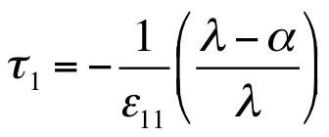
V. Optimal taxation: no redistribution concerns (IX)
Analytical development: OPTIMAL consumption taxes (iv)
- We can re-express it using the compensated elasticity, , and recall τ₁=t₁/q₁ (ad-valorem tax including taxes), as follows:
Inverse elasticity rule
As expected, those goods or services with a higher compensated elasticity should be more heavily taxed (e.g., necessity goods…, in the limit case, for sticky goods, tax rates should tend to infinity… according only to efficiency).
- 2nd. Particular Tax rule (first order approximation, i.e., do not necessarily work with infinitesimal variations). We go back to the FOC:
...

Slide 24
V. Optimal taxation: no redistribution concerns (X)
Analytical development: OPTIMAL consumption taxes (v)
- …, that is,
, where Δx₁/x₁: “discouragement index” (Mirrlees,
1976).
Then, an alternative reading of the rule is that: taxation should discourage demand in the same proportion (approx.). The real impact of taxation should not differ much among consumption goods or services. See efficiency in terms of X’s.
- General Tax Rule or Ramsey Rule (+ income + cross price effects at work). We go back to the original FOC:
, having used the Slutsky equation; further
development:

Slide 25
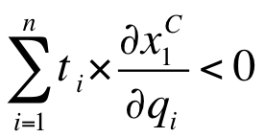
V. Optimal taxation: no redistribution concerns (XI)
Analytical development: OPTIMAL consumption taxes (vi)
on the LHS we have the substitution effect (source of inefficiency). We define (i.e., effects of introducing a 1€ lump sum transfer to the individuals):
: Net Social Marginal Utility of Income (Diamond, 1975),
wrt the marginal utility of public funds (numeraire).
This is the marginal gain for society of transferring one unit of income to the private sector. It is net because this transfer generates an increase (decrease) in tax revenues due to more (less) private consumption.
Next, we make use of the symmetry property of compensated demand, that is, ; also recall the substitution matrix is negative semi-definite (i.e., ).

Slide 26
V. Optimal taxation: no redistribution concerns (XII)
Analytical development: OPTIMAL consumption taxes (& vii)
All in all, it makes the above condition transforms into:
, where b<1 in order tax rates are positive.
Recall this comes out of the FOC for good/service 1, and also that the LHS is picking up the so-called “index of discouragement”. Therefore, the Ramsey Rule tells us that optimal tax rates must be such that the reduction of compensated demand (wrt its initial level of consumption) must be the same for all goods and services. That is,
In practical terms, though, this is not very informative. For example, key question: does this imply tax rates should be uniform? (no distortions… among taxed goods?)

Slide 27
V. Optimal taxation: no redistribution concerns (XIII)
Analytical development: Should optimal consumption taxes be uniform? (i)
Will see next the answer is NO; the origin, though, is different from that observed under tax rule 1 and tax rule 2.
Analytically, we are wondering whether r ∀i . That is, whether all goods – due just to efficiency considerations - should be taxed at 21%. Before demonstrating our NO, let’s see what’s going on in practice:
Source: Durán-Cabré (2013); Index of uniformity (C-efficiency): effective tax rate (macro measure)/statutory general tax rate (if it equals one, perfect uniformity)… Is NZ doing so well?
 | 2003 | 2005 | 2007 | 2008 | 2009 | Average
Spain | .53 | .56 | .55 | .46 | .35 | .49
EU(15) | .55 | .57 | .57 | .55 | .49 | .55
OECD | .57 | .59 | .60 | .58 | n.a. | .59
New Zealand | 1.07 | 1.03 | .97 | .98 | n.a. | 1.01

Slide 28
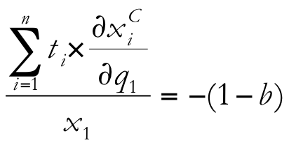
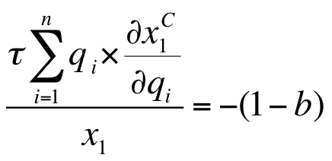
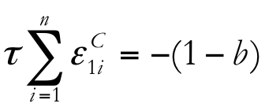
V. Optimal taxation: no redistribution concerns (XIV)
- Let’s write again the Ramsey Rule:
We employ the symmetry property and work with ad-valorem taxes:
(When) Is this optimal?
In order the answer is YES, the following condition must hold:
, ∀ i , i=1,…,n
As we will show, this implies all goods should be equally complementary with (untaxed) leisure (“weak separability”). This would happen if individual preferences between commodities and leisure are quasi-separable (Deaton, 1981). But, this is unlikely as we will see next.
Analytical development: Should optimal consumption taxes be uniform? (ii)

Slide 29
V. Optimal taxation: no redistribution concerns (XVI)
Analytical development: Should optimal consumption taxes be uniform? (& iii)
Compensated demand function is homogeneous of degree zero in prices. That is, if we change all prices in the same percentage, demand remains unchanged. There is no substitution effect. That is,
Thus, the LHS of the previous FOC becomes (recall: representative taxpayer):
which should hold for all FOC. In the end, uniform consumption taxation is optimal as long as:
That is, all goods/services should show the same degree of complementarity with leisure (x_{o}), which is quite unlikely (see the empirical study by Browning and Meghir, 1991, which rejects “weak separability”; and Molina, 1999, for Spain with the same result). Next, more recent estimates…

Slide 30
Crawford et al. (2008): complementarities with leisure
+: less heavily taxed; -: more taxed.. In any case, the important is that the (estimates of the) impact is not equal for all commodities– but still, economic efficiency vs. administrative efficiency // see also West & Williams III (2007)

Slide 31
V. Optimal taxation: no redistribution concerns (XVII)
Analytical development: Theorem of Corlett-Hague (1953) (i)
Let’s then look for a more informative rule for tax design, where the key dimension regarding commodity taxation seems to be the degree of complementarity of each good with leisure.
Let’s suppose 2 goods + leisure (untaxed), i=0,1,2. The (two) corresponding FOC’s are the following:
which we conveniently re-express as follows:
t₁S₁₁+t₂S₁₂=-(1-b)x₁
t₁S₂₁+t₂S₂₂=-(1-b)x₂ …. and now obtain each implicit optimal tax rate

Slide 32
V. Optimal taxation: no redistribution concerns (& XVIII)
Analytical development: Theorem of Corlett-Hague (1953) (& ii)
That is,
, s.t. D<0 (substitution matrix negative semi-definite)
, and making use of homogeneity of degree 0 in prices
Subtracting t₂-t₁:
, so : good 1 is relatively
more complementary with leisure. This theorem implies goods complementary with leisure should be more heavily taxed… For example, cinema sessions at 4pm on Monday should be taxed more heavily than cinema sessions at 4pm on Saturday. Also, gardener or plumber services should also be less taxed if leisure=self-supply (Kleven et al., 2000)

Slide 33
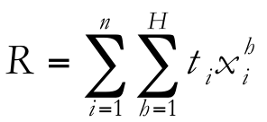
VI. Optimal taxation: with redistribution concerns (I)
We have H-individuals, who now might be different according to their level of income… So, redistribution (different treatment according to their initial different level of utility might be an issue implicitly or explicitly)
Analytical development based on Diamond (1975), JPubEco.
Basically, what changes is the objective function of the Social Planner:
This function is increasing in all its arguments, and quasi-concave, W_{vi}>0>W_{vi,vi}. That is, it shows explicit aversion to inequality
The budget constraint is now:
The tax rate is potentially different among commodities; and the consumption level for each i-commodity might differ among the H-consumers.

Slide 34
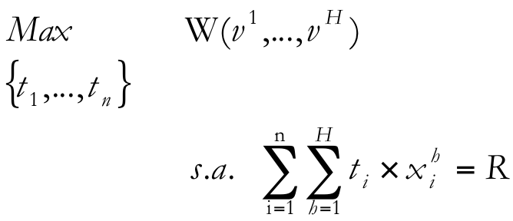
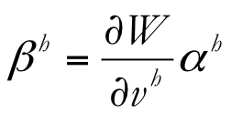
VI. Optimal taxation: with redistribution concerns (II)
Analytical development: Optimal tax rates under heterogeneity (i)
The maximization problem is the following:
The FOC for the i-commodity (and similarly for the rest of n-1 commodities taxed):
We define the social marginal utility of income as:
which is not constant, as individuals differ in their initial endowment (Y), and so their private marginal utility of income will also differ. Note, there is no need for a concave transformation of the SWF to promote redistribution as long as marginal utility of income is decreasing.

Slide 35
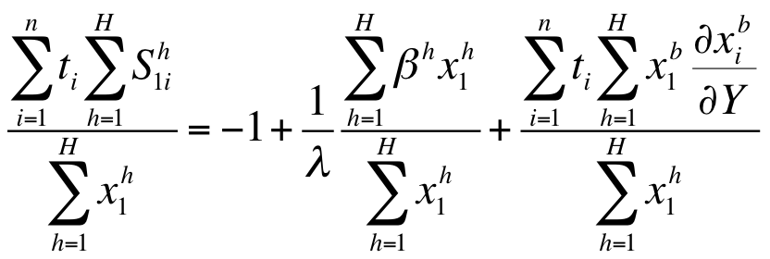
VI. Optimal taxation: with redistribution concerns (III)
Analytical development: Optimal tax rates under heterogeneity (ii)
Given the previous definition, the FOC becomes:
Now, using Slutsky equation:
The, once we work a little bit on it, have a first interpretation:
The “index of discouragement” should be lower (wrt commodity 1) as long as there is a high correlation between the betas and x₁, and vice versa. Equity at work in the absence of any other tax (PIT, for example).

Slide 36
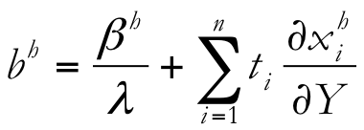
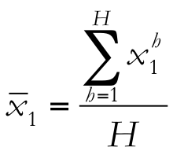
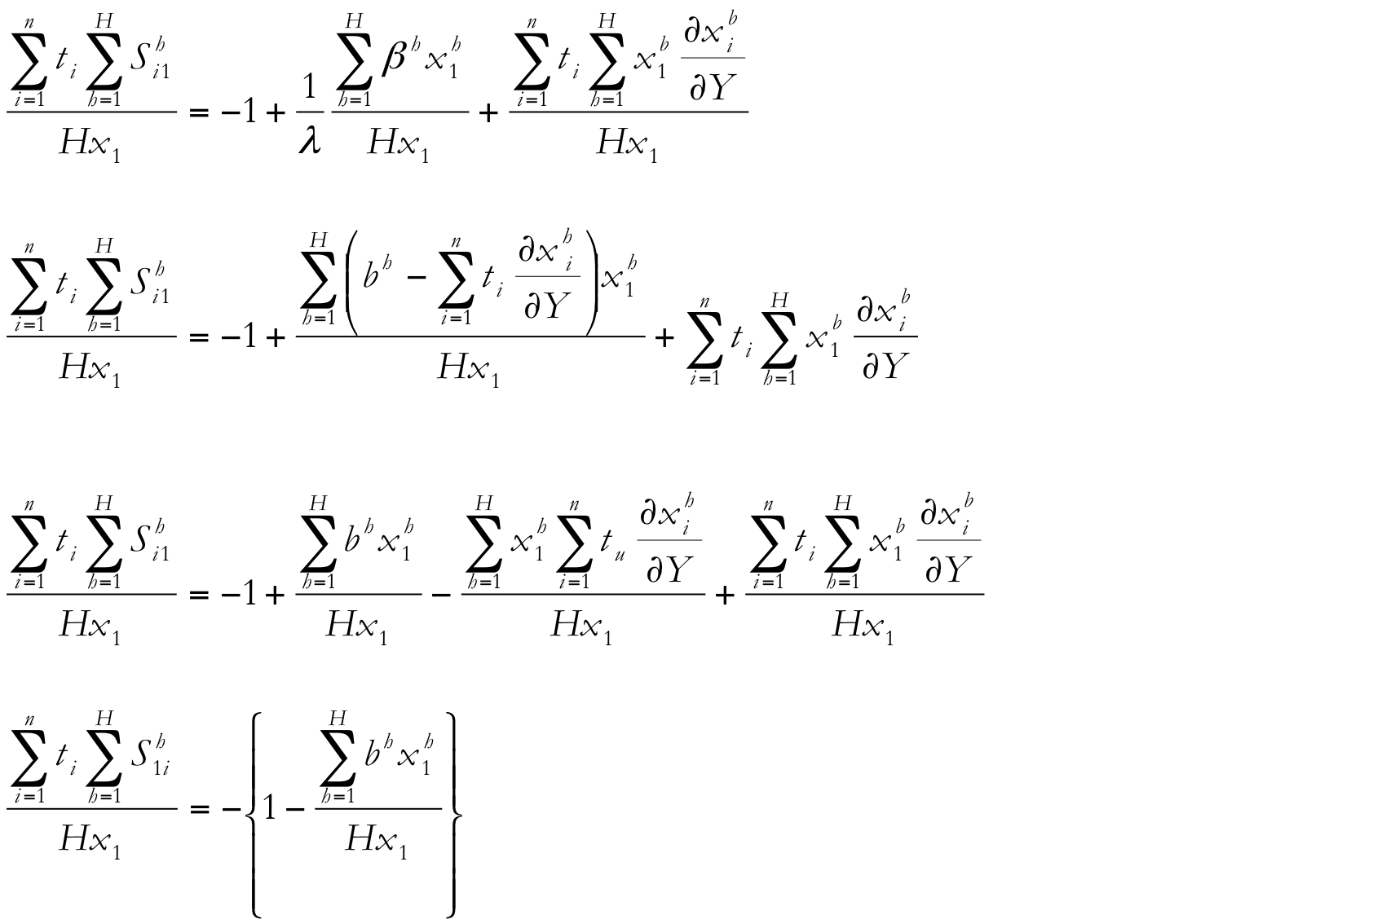
VI. Optimal taxation: with redistribution concerns (IV)
Analytical development: Optimal tax rates under heterogeneity (iii)
In order to obtain a more compact FOC and so a clear-cut rule, we operate on the previous condition defining again net marginal utility of income wrt public revenues (numeraire), , , and the average consumption of commodity 1, .
Tedious operations take us to (which gives the same indication than before):

Slide 37
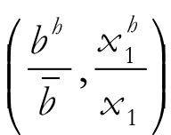
VI. Optimal taxation: with redistribution concerns (V)
Analytical development: Optimal tax rates under heterogeneity (iv)
Finally, we define Φ as the covariance . That is, , and so .
Plugging this latest expression in the latest condition, we obtain:
So, for a given , the “index of discouragement” will be higher, the lower Φ (for commodity 1). Special cases:
Φ=0. Commodity taxes are not useful for redistribution as they do not embody relevant information regarding income levels (poor have greater weight in the SWF). No difference wrt the case of identical consumers.
Obviously, the same conclusion holds if =b^{h (}e.g., utilitarian SP being private marginal utility of income constant).

Slide 38
VI. Optimal taxation: with redistribution concerns (& VI)
Analytical development: Optimal tax rates under heterogeneity (& v)
Atkinson & Stiglitz (1976). In the presence of an optimum non-linear tax (next topic), no differential commodity taxes should be applied for redistribution purposes (see, for example, Salanié, Ch. 5). In a sense, for redistribution purposes, it is preferable a PIT (or uniform commodity taxation!!). Different productivities (skills-wages) provoke differences in income, but no differences in relative demands for goods, only in scale. However, we know this does not hold in practice, and so differential commodity taxes are optimal (Edwards et al., 1994). Will show this in the next chapter.
Weak separability make utility function takes the following shape (see, for example, Deaton, 1986, section 4.1):
V=V(V_{r}(q_{r}),q_{l}) There are two groups of commodities: leisure (indexed by l) and the rest (indexed by r). This implies that the individual, first, chooses, between leisure and consumption as a whole, and next among commodities. Hence, the decision about relative demands is not affected by the price of leisure.

Slide 39
VIII. Basic References
Myles, G. (1995): Public Economics, Chapter 4 (link from his very webpage: http://people.exeter.ac.uk/gdmyles/papers/pdfs/pubec.pdf), CUP.
Salanié, B. (2003): The Economics of Taxation, Chapter 3, MIT Press.
------
Hindriks, J., G. Myles (2006): Intermediate Public Economics, Chapter 15, MIT Press.
Crawford, I., M. Keen, S. Smith (2010): “Value Added Taxes and Excises”, Chapter 4 (http://www.ifs.org.uk/mirrleesreview/dimensions/ch4.pdf), Mirrlees Review, The Institute for Fiscal Studies.

