Slide 1
The Basics of Cancer Biology
Lucio Miele, M.D., Ph.D.

Slide 2
Part III: “The Pianist and the Piano”
Bad music, stem cells and bad luck

Slide 3
The genetic piano

Slide 4
The genetic piano - 2
Our genomes can be compared to piano keyboards, where each key is a gene
Each piano key produces a note, a sound of specific wavelength
Each gene produces a transcript of specific sequence
Notes combine in time to produce chords and melodies
The musical effect of a note depends on what other notes are played with it (e.g., major chord, minor chord, seventh chord, dissonance)

Slide 5
The genetic piano - 3
Similarly, genes work in teams. The phenotypic effect of a gene depends on what other genes are “playing” at the same time
When genes that should not be “playing” together are expressed together, aberrant phenotypes result
When a physical problem occurs within a particular key or the strings it sounds, that key is mechanically out of tune. It is unable to produce the correct note no matter who plays it, or it may not play at all.

Slide 6
The genetic piano - 4
When a physical alteration (mutation) occurs in a gene, it produces a mutant transcript, or it may produce an unstable or truncated transcript. It cannot produce a normal transcript, no matter the circumstances
Mutations are “out of tune” genes, that produce transcripts which disturb the melody of life when played

Slide 7
The epigenetic pianist

Slide 8
The epigenetic pianist -2
Even a perfectly tuned piano key can modulate its note:
It can modulate sound intensity: it can play its note “pianissimo”, “piano”, “forte”, “fortissimo”
It can modulate intensity also by using the soft pedal: “una corda”
It can modulate the duration of sound when the pedals are used: “sostenuto”
The quality of sound produced by a piano depends on WHO is playing it, HOW the pianist plays, and WHAT NOTES are played TOGETHER

Slide 9
The epigenetic pianist -3
Extracellular signals from the environment modulate gene expression through epigenetic mechanisms
Each gene can be expressed at high level (producing many molecules of transcript, “forte” or “fortissimo”), at low level (fewer molecules of transcript, “piano” or “pianissimo”) or not at all (the key is not played)

Slide 10
The epigenetic pianist -4
Each gene can be expressed for long or short periods of time (“sostenuto” or “natural”)
Each is expressed together with other genes, determining the overall phenotype (chords and melodies)
Our genomes are capable of responding to environmental stimuli by turning groups of genes off or on, or modulating their expression. This is accomplished through epigenetic mechanisms.

Slide 11
The epigenetic pianist -5
Epigenetics is how the environmental pianist plays the genetic piano
We each have our own keyboards of genes that we are born with. Some may be mutant (out of tune) and others are in tune
The output of these genes is “played” by the environment by regulating the physical structure of chromatin where genes are located, without a need to change the actual DNA sequence
Genes can be epigenetically activated or inactivated

Slide 12
How the piano is played
Epigenetic phenomena regulate the expression of genes by modifying the chromatin structure and function of the genes themselves or of regulatory regions controlling the transcription of genes (promoters, enhancers, insulators, super-enhancers)
This is achieved at least in part by a series of post-translational modifications of DNA itself (DNA methylation, generally of cytosine residues) and of chromatin proteins (particularly histones)
More recently, mRNA and snRNA modifications have been described

Slide 13
Epigenetic modifications
DNA methylation
Histone modifications
Acetylation
Methylation
Phosphorylation
Sumoylation
Others

Slide 14
Epigenetic modifications
Often, modified DNA and/or histones recruit other proteins that stabilize modified chromatin structure, thus maintaining the chromatin structure
Some of these modifications can be transmitted through mitotic cycles, and some can even be inheritable into the next generation
Thus, epigenetics provides mechanisms whereby genomes respond to environmental stimuli without changing the actual DNA sequence
These changes can under some circumstances be inheritable

Slide 15
Epigenetic modifications and cancer
In the context of cancer, epigenetic mechanisms can inactivate or activate genes without mutations being detectable by DNA sequencing
Specialized techniques like DNA methylation analysis and ChIP-Seq, or 3D chromatin analysis
Through epigenetics, cells can change their phenotype WITHOUT ADDITIONAL MUTATIONS, acquiring stem-like characteristics (PHENOTYPIC PLASTICITY)
For example, the cellular stress associated with detachment from a basement membrane and survival in a hypoxic environment can trigger EMT. In turn, EMT can produce Cancer Stem Cells by inducing epigenetic modifications in cell fate genes

Slide 16
The concept of “cancer stem-like cells” (CSC) and “epithelial-mesenchymal transition” (EMT)
Recent research has shown that to acquire all these biological properties, epithelial cancer cells must lose some of their epithelial characteristics and become more similar to a mesodermal (mesenchymal) cell. This phenomenon is called EMT. It involves changing surface adhesion molecules (from E-cadherin to N-cadherin), changing cytoskeletal structure to allow mobility (this requires expression of vimentin intermediate filaments and reorganization of actin filaments. It also causes cancer cells to acquire “stem cell-like” behavior.
Once EMT cells reach sites of metastasis, they revert to a more epithelial-like phenotype, through a process called MET (phenotypic plasticity)

Slide 17
“Stemness” is a phenotype that can be acquired through several paths
Self-replication
CSC
TSC
TSC
Progenitor
Asymmetric
Cell
division
EMT,
“de-differentiation”
Proliferation,
differentiation
Differentiated cells

Slide 18
CSCs are highly tumorigenic in immune-deficient mice and highly resistant to chemotherapy
Tumorigenicity
Self-replication
CSC
Asymmetric
cell division
CSC
“Progenitor”
Chemosensitivity
“Bulk” cancer cells

Slide 19
CSCs are generally driven by evolutionarily conserved developmental pathways
The “typical” CSC shows pluripotency (ability to differentiate into different lineages), asymmetric cell division (ability to generate more CSC and more “differentiated” cancer cells) and ability to survive in a low-proliferation state for extended periods of time (DORMANCY)
These phenotypes are driven by the activity of highly conserved gene networks used during cell fate decisions by embryonic stem cells and tissue stem cells are
These pathways typically control the gene expression profile of a cell and modulate differentiation, proliferation, death and metabolism

Slide 20
Some developmental pathways are being targeted pharmacologically
Examples include:
Notch
Hedgehog
Wnt
These pathways are directly or indirectly activated in many tumors, through mutations in pathway components, overexpression, loss of negative regulators (tumor suppressors), epigenetic dysregulation etc.
They are pleiotropic and control thousands of other genes
They also work together (crosstalk)

Slide 21
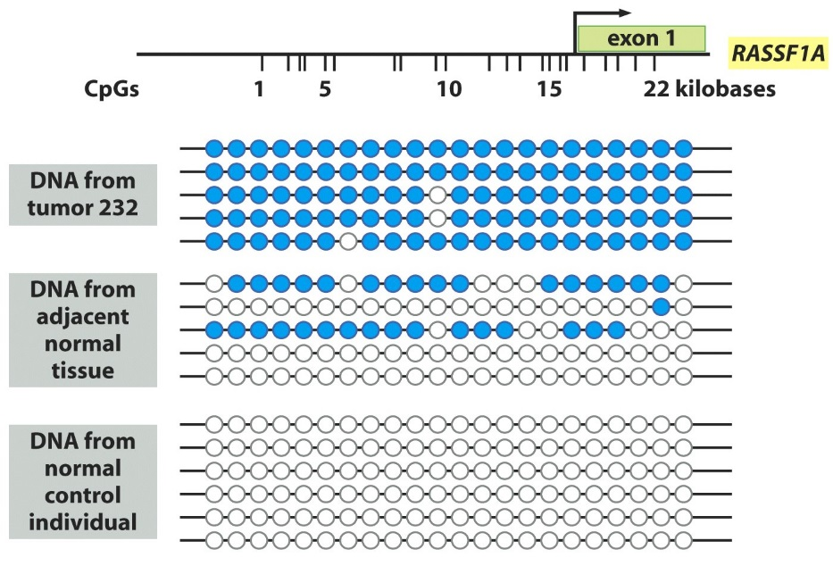
Tumor Suppressors: Silencing Through Epigenetics
Genes can be silenced through methylation of the promoters, which results in the silencing of the expression of that particular gene.
In example at left - the methylation status of the RASSF1A promoter (involved in many types of cancer) was examined in a tumor sample, adjacent non-tumorous cells, and a normal individual.
It was found that the tumor sample showed hypermethylation of CpG islands relative to the adjacent normal, suggesting that the expression of the gene is silenced by epigenetic effects in the tumor cell.
Silencing of tumor suppressors by methylation is becoming to be viewed to be just as important in silencing tumor suppressor genes as are somatic mutations.

Slide 22
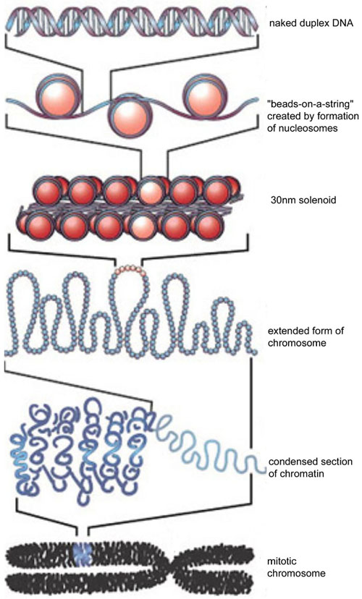
Chromatin physical structure controls gene expression
Strahl and Allis, Nature 403, 41-45 (6 January 2000)

Slide 23
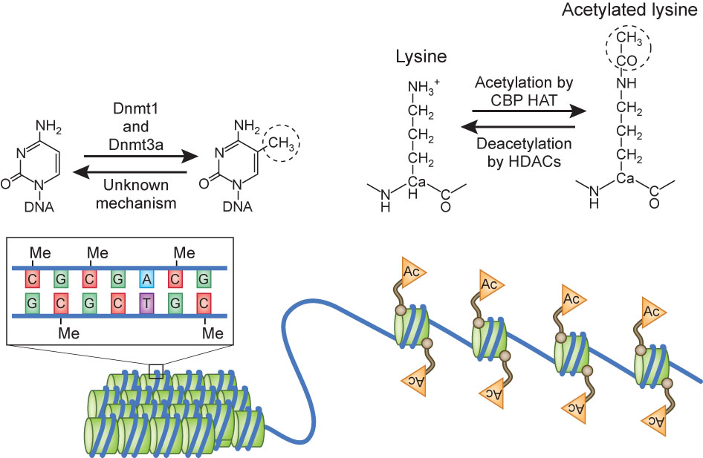
DNA Methylation and Histone acetylation control chromatin structure
Korzus, Nature Neuroscience 13, 405–406 (2010)

Slide 24
Class | Enzymes | Enzymes | Enzymes
Histone Acetyltransferases (HATs) | ELP3/KAT9 | PCAF/KAT2B | MORF/MYST4/KAT6B
 | GTF3C4 | CBP/KAT3A | HBO1/MYST2/KAT7
 | HAT3 | p300/KAT3B | MOF/MYST1/KAT8
 | HAT1/KAT1 | Tip60/KAT5 | KAT10
 | GCN5/KAT2A | MOZ/MYST3/KAT6A | TFIIIC90/KAT12
Histone Deacetylases (HDACs) | HDAC1 | HDAC7 | SIRT2
 | HDAC2 | HDAC8 | SIRT3
 | HDAC3 | HDAC9 | SIRT4
 | HDAC4 | HDAC10 | SIRT5
 | HDAC5 | HDAC11 | SIRT6
 | HDAC6 | SIRT1 | SIRT7
Histone Methyltransferases (HMTs) | ASH1 | NSD1/KMT3B | SETD1A
 | Clr4/KMT1 | PRMT1 | SETD8/Pr-SET7/KMT5A
 | Dot1L/KMT4 | PRMT3 | SETDB1
 | EZH2/KMT6 | PRMT4/CARM1 | SETDB2/KMT1F/CLL8
 | G9a/EHMT2 | PRMT5/JBP1 | SMYD2/KMT3C
 | GLP/EHMT1 | PRMT6 | SUV39H1
 | KMT5B/KMT5C | Riz1/Riz2/KMT8 | SUV39H2
 | MLL1 | NF20 | SUV4-20H2/KMT5C
 | MLL2 | RNF40 | TRX/ KMT2a
 | MLL3 | SET1A | HIF-1/ SET2/HYPB/KMT3A
 | MLL4 | SET1B
 | MLL5 | SET7/9
Histone Demethylases (HDMs) | ARID1A | JHDM1b/FBXL10/KDM2B | JMJD2D/KDM4D
 | ARID5B | JHDM2A/KDM3A | JMJD3/KDM6B
 | JARID1A/RBBP2/KDM5A | JHDM3A/JMJD2A/KDM4A | LSD1/KDM1
 | JARID1B/PLU1/KDM5B | JMJD1A | LSD2
 | JARID1C/SMCX/KDM5C | JMJD1B/KDM3B | PHF2
 | JARID1D/SMCY/KDM5D | JMJD2A | PLU1
 | JHD1/KDM2 | JMJD2B/KDM4B | UTX/KDM6A
 | JHDM1a/FBXL11/KDM2A | JMJD2C/GASC1/KDM4C
DNA Methyltransferases (DNMTs) | DNMT1 | DNMT3b | DNMT1o
 | DNMT3a | DNMT3L
DNA Demethylases | TET1 | TET2 | TET3

Slide 25
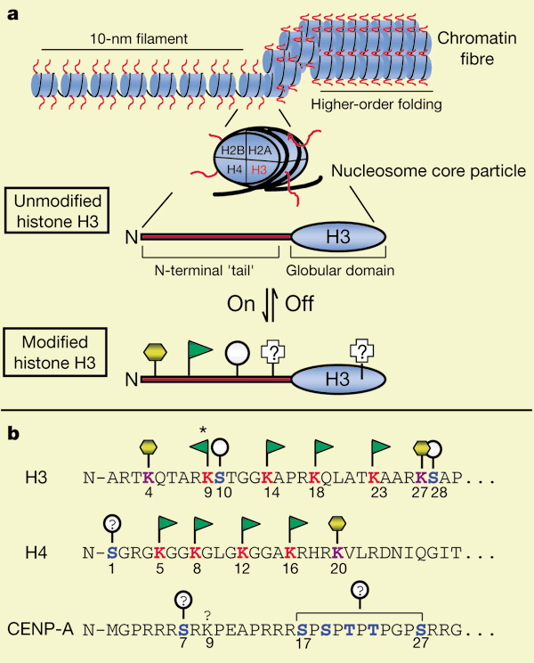
The Histone Code
Strahl and Allis, Nature 403, 41-45 (6 January 2000)

Slide 26
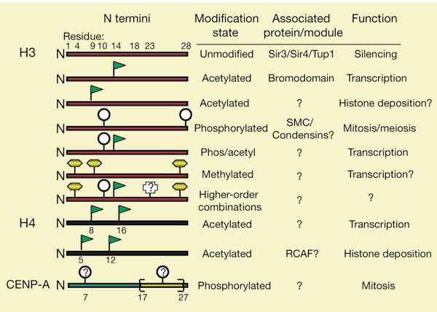
The Histone Code -2
Strahl and Allis, Nature 403, 41-45 (6 January 2000)

Slide 27
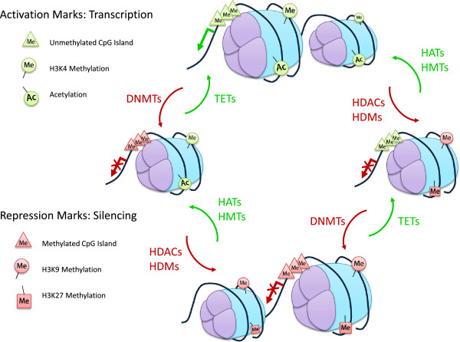
Methylation and Acetylation work together
Baxter et al. Cell & Bioscience 2014, 4:45

Slide 28
Factors that can have epigenetic effects
Within tissues
Hypoxia, acidosis, metabolic stress, specific metabolites (e.g., short chain fatty acids), ROS produced by inflammation etc.
Insulin, hyperglycemia, adipokines (obesity, T2D)
From the environment
Pollutants, substances of abuse (tobacco, others, either directly or through inflammation)
Nutritional molecules (e.g., food additives, byproducts of cooking, excess fat)
The MICROBIOME (products from the bacterial flora in the body, which is itself affected by diet)

Slide 29
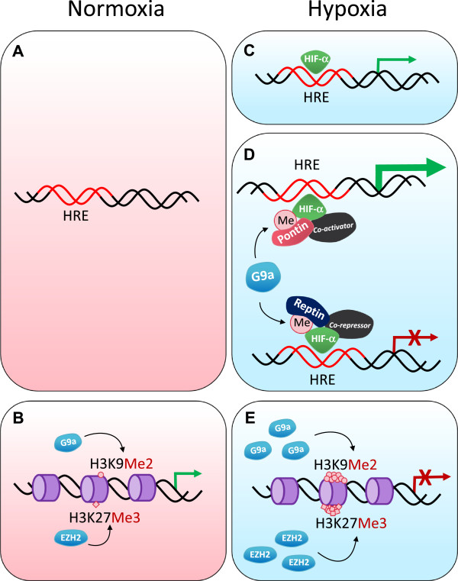
Epigenetic effects of hypoxia
Baxter et al. Cell & Bioscience 2014, 4:45

Slide 30
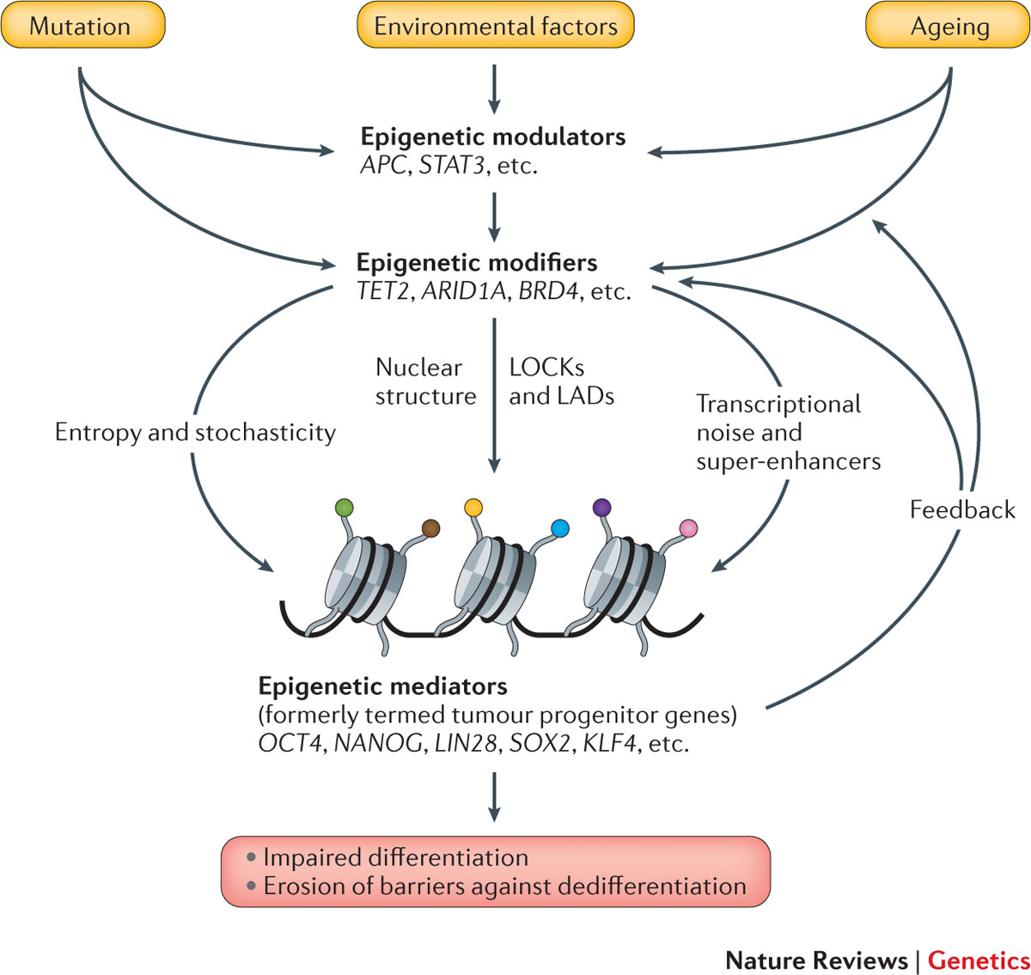
How epigenetics affects cancer risk
Feinberg et al. Nature Reviews Genetics 17, 284–299 (2016)

Slide 31
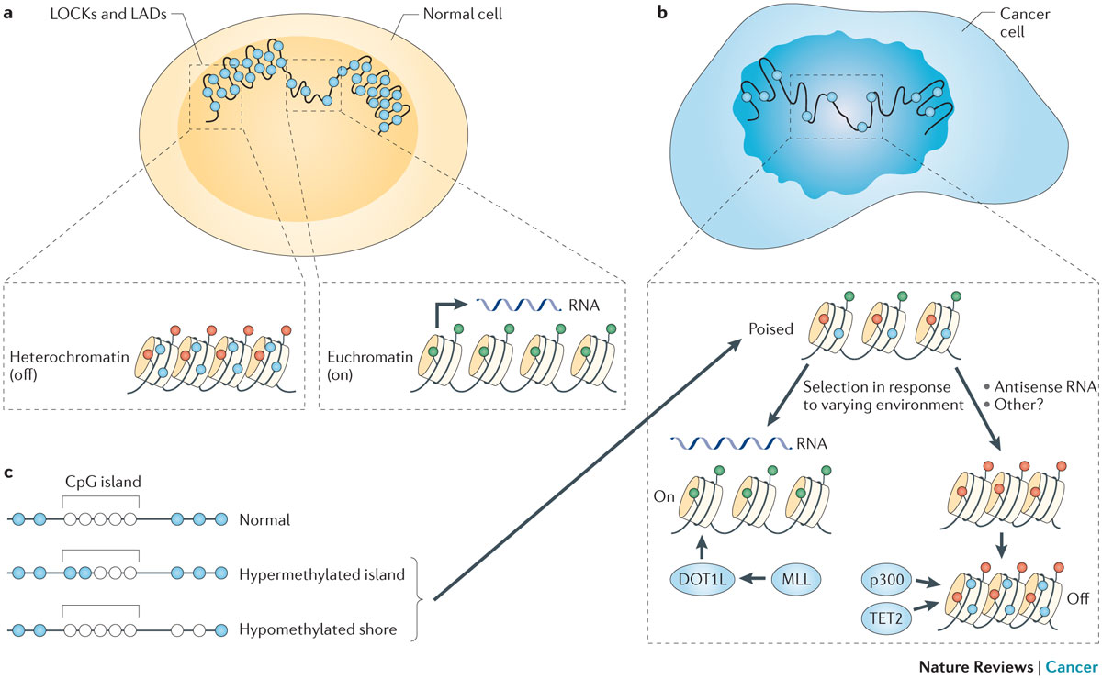
Timp and Feniberg, Nat Rev Cancer. 2013 Jul;13(7):497-510

Slide 32
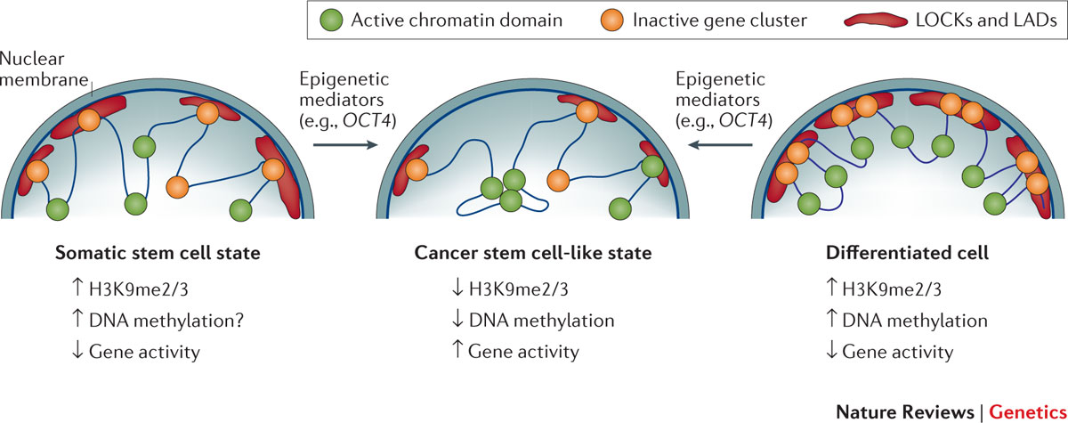
Chromatin structure in CSC, normal tissue stem cells and differentiated cells
Feinberg et al. Nature Reviews Genetics 17, 284–299 (2016)

Slide 33
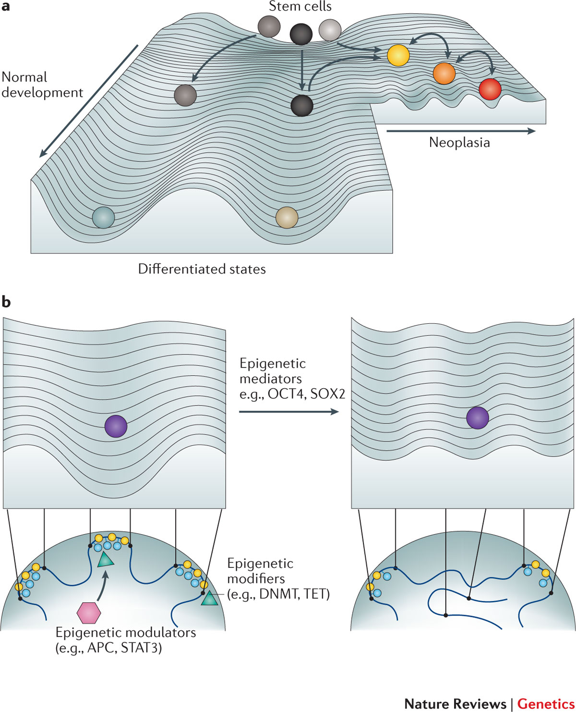
Epigenetic modification changes the probability of normal differentiation for stem cells
Feinberg et al. Nature Reviews Genetics 17, 284–299 (2016)

Slide 34
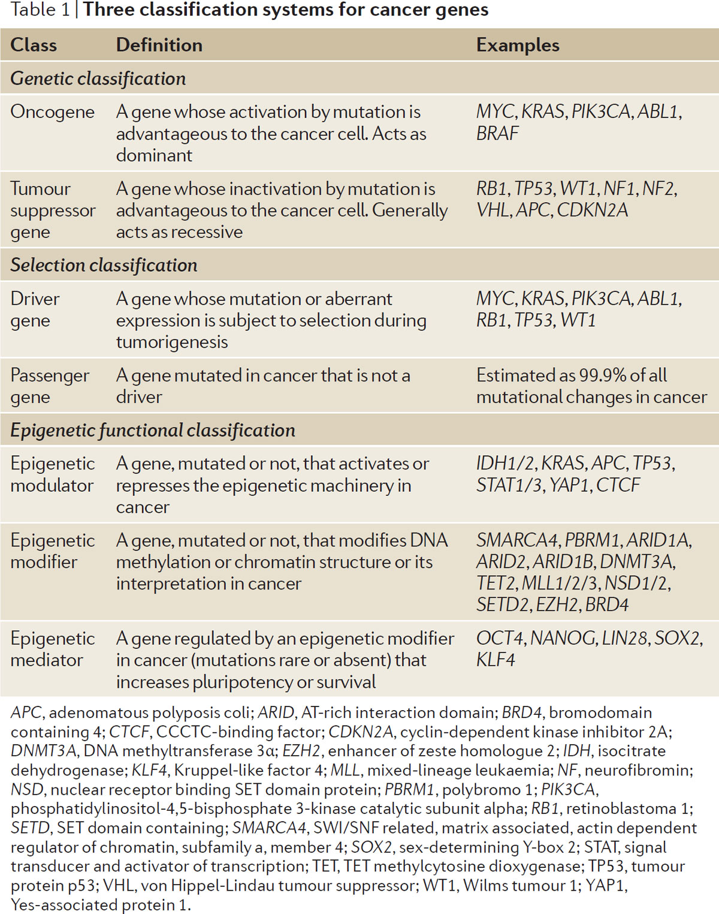
Feinberg et al. Nature Reviews Genetics 17, 284–299 (2016)

Slide 35
Feinberg et al. Nature Reviews Genetics 17, 284–299 (2016)

Slide 36
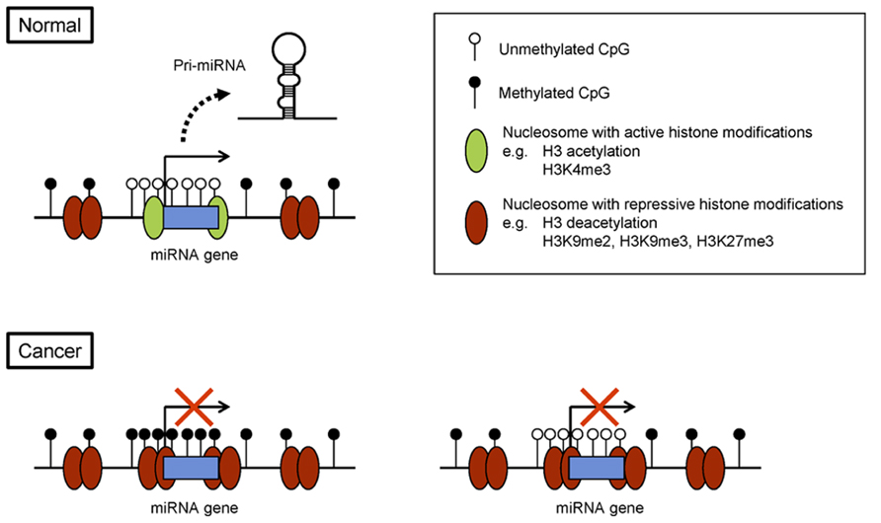
miRNAs and epigenetics: a two-way street
Suzuki et al., Front. Genetics (2014)

Slide 37
miRNAs and epigenetics: a two-way street
Suzuki et al., Front. Genetics (2014)

Slide 38
And the latest addition…LncRNAs!
Beckedorff et al. Biosci Rep. 2013 Aug 30;33(4)

Slide 39
LncRNAs act as oncogenes or TSG
lncRNA | Cancer type | Function/characterization
ANRIL/p15AS | Leukaemia, prostate | Binds to PRC1 and PCR2; required for the PRC2 recruitment to and silencing of p15 tumour suppressor gene
HOTAIR | Breast, hepatocellular, colorectal, gastrointestinal, pancreatic | Epigenetically silences gene expression at the HOXD locus interacting with PCR2 and LSD1 complexes
CTBP1-AS | Prostate | Androgen-responsive; represses CTBP1 expression by recruiting PSF together with histone deacetylases; promotes cell growth
PCAT-1 | Prostate, colorectal | Inhibits BRCA2; promotes cell proliferation
ANRASSF1 | Possibly prostate, breast | Binds to PRC2, represses RASSF1A tumour suppressor gene; increases cell proliferation
HOTTIP | Possibly leukaemia | Interacts with WDR5/MLL complex, which catalyses the deposition of the activating H3K4me3 mark and the transcriptional activation of the HOXA locus
XIST | Leukaemia, histiocytic sarcoma | Interacts with PRC2; epigenetically controls dosage compensation by silencing of X chromosome; suppresses cancer in vivo
Beckedorff et al. Biosci Rep. 2013 Aug 30;33(4)

Slide 40
But wait…There’s more! Epitranscriptomics!
Epitranscriptomics is the post-transcriptional modification of RNA molecules by enzymes
These can affect RNA stability, structure and function
Adenine 6-methylation creates binding sites for RNA binding protein
Pseudouracyl residues can be introduced not only in tRNAs, where they are well known, but also in other cellular RNAs including those involved in transcript splicing

Slide 41
But wait…There’s more! Epitranscriptomics!
Nature Structural & Molecular Biology 23, 98–102 (2016)

Slide 42
Is Cancer just a matter of bad luck?
http://science.sciencemag.org/content/347/6217/78.full.pdf+html
http://www.nature.com/nature/journal/v529/n7584/pdf/nature16166.pdf
In a word….
NO

Slide 43
Cancer risk is a function of intrinsic mutation rate AND extrinsic factors
http://www.nature.com/nature/journal/v529/n7584/pdf/nature16166.pdf

Slide 44
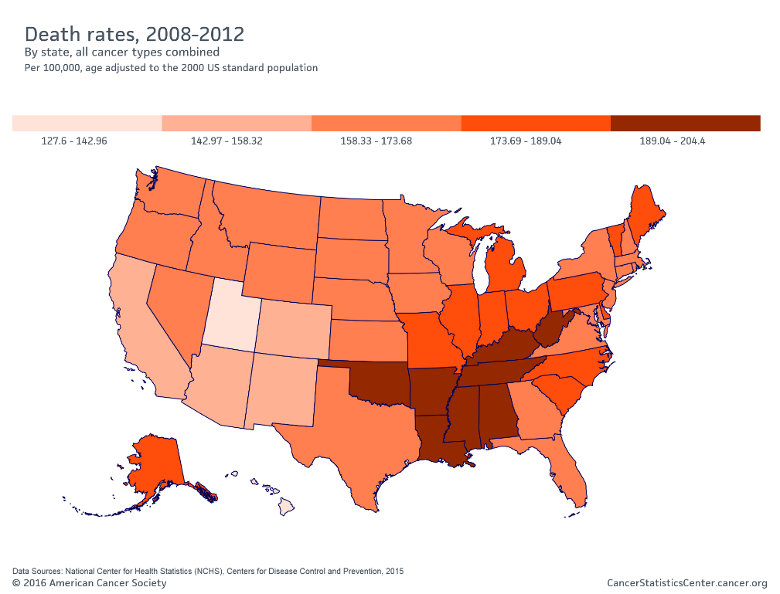
Socioeconomic factors affect cancer incidence and mortality
Kentucky: tobacco producing state, high rates of smoking: highest lung cancer rates in the US
North-East: wealthy area, good health care but urban living, pollution, chronic stress. Good access to health care
Mid-South: very high obesity rates, diabetes, low socioeconomic status, more limited access to health care and prevention

Slide 45
Extrinsic factors affect cancer risk
Genetic variation in DNA repair pathways
Mutagens in the environment
EPIGENETIC AND EPITRANSCRIPTOMIC EFFECTS from environmental stimuli can modify both the phenotype of cells (phenotypic plasticity leading to stemness) and the rate of intrinsic mutations
Our genomes (and transcriptomes) are not rigid systems, but they are responsive to the outside environment (what we eat, breathe, absorb through our skin, circadian rhtyhms, bacterial metabolites, our body composition etc. etc.)
In fact, according to the ACS, 60% of cancers could be prevented by avoiding tobacco products and obesity
Bad luck is not a good enough excuse to avoid cancer prevention!

